Slide 1
Southeast Seattle Education Coalition
DEPARTMENT OF TECHNOLOGY SERVICES (DOTS)
Presented by: Carmen A. Rahm, CIO
With David Oestreicher, Director of Technology Infrastructure
and Colleen Halvorson, Manager of Technology Support Services
April 2016 Meeting

Slide 2
Main Topic: SPS’s Technology Vision for Teaching & Learning: Creating Equity Throughout the District
Discussion Question: What can the Department of Technology Services do to provide equitable access to technology, and ultimately equitable access to a quality learning experience, for all students across SPS and in the Southeast Region?
CREATING THE COMMON VISION:
The Teaching & Learning Technology Vision Summit and Town Hall Meetings (Quick Overview) 10 minutes
The Teaching & Learning Technology Vision: A Day in the Life of a 21st Century SPS Student (Video & Discussion) 10 minutes
QUESTIONS & DISCUSSION 10 minutes
SMALL GROUP ACTIVITY 20 minutes
What is the SESEC Vision for Technology in T&L?
How can DoTS help make the SESEC Vision a Reality?
WRAP-UP and NEXT STEPS 10 minutes

Slide 3
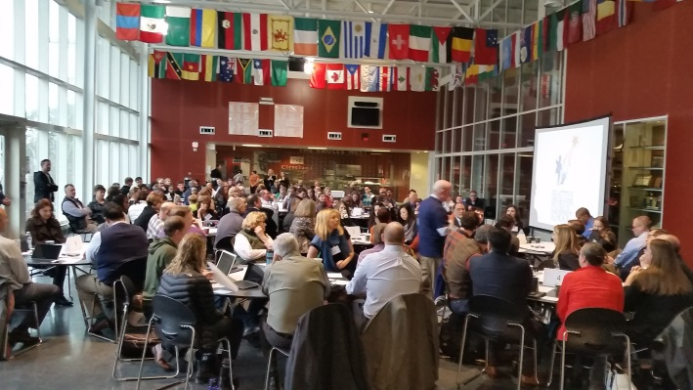
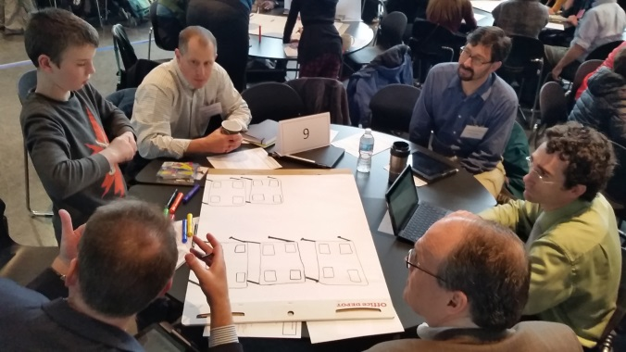
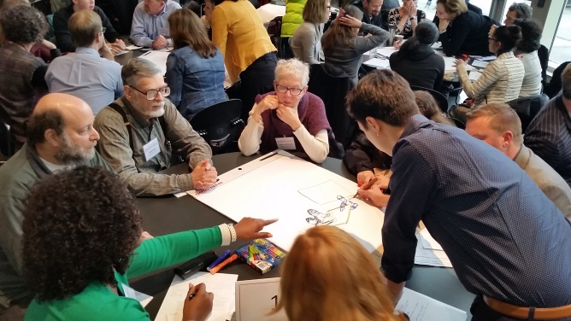
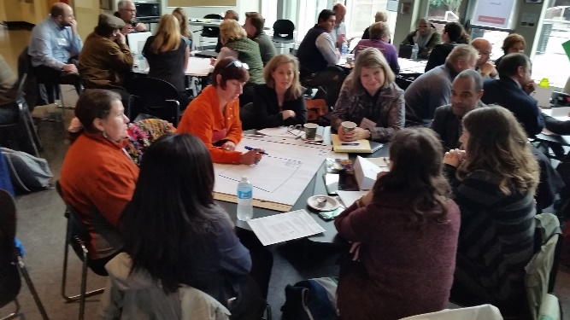
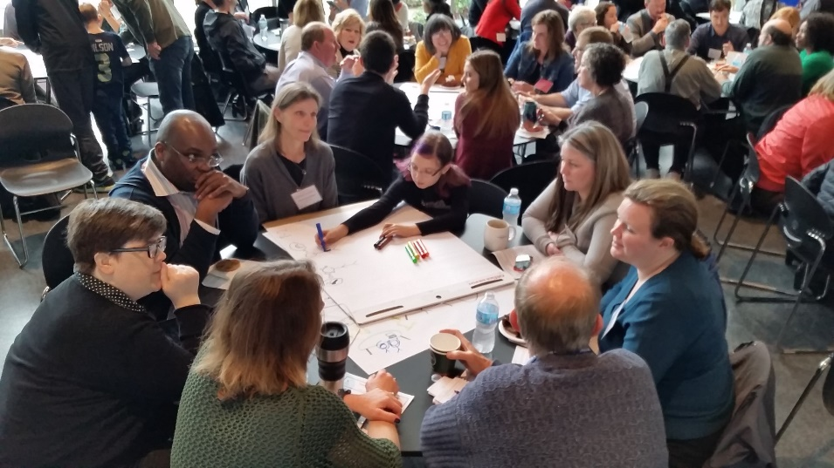
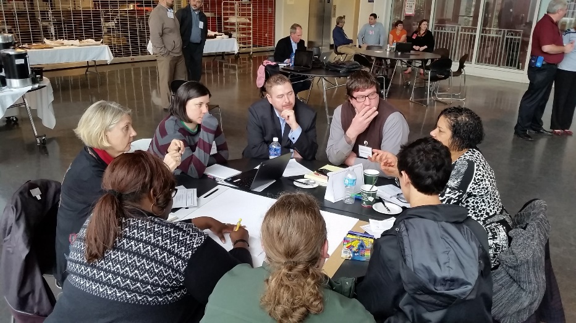
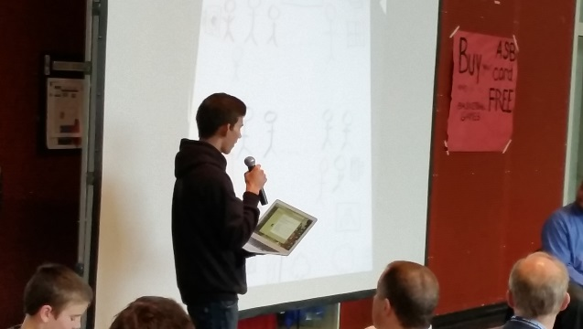
Table 8, with 5th grade student, develops one of their 3 sketches
Hosted at Cleveland HS
Table 4 ,with HS student, develops one of their “Day In
The Life” sketches
Table 12 discusses options for one of their “Day In The Life” sketches
Student presents to Summit attendees
Scenes from the 2015 Teaching & Learning Technology Vision Summit
(120 Students, Parents, Teachers, Principals, District Leaders, Community Partners, and
Educational Technology Partners)

Slide 4
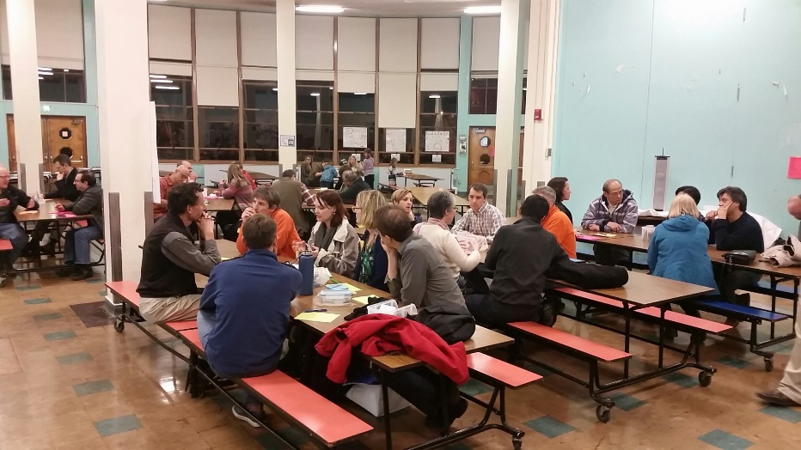
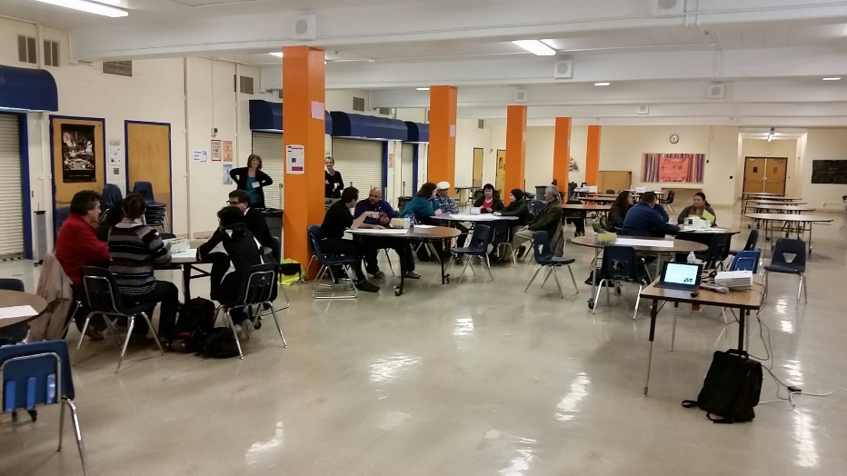
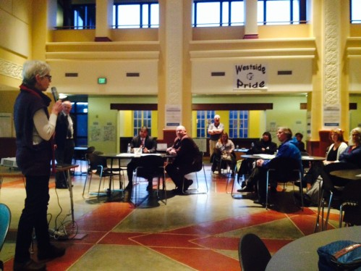
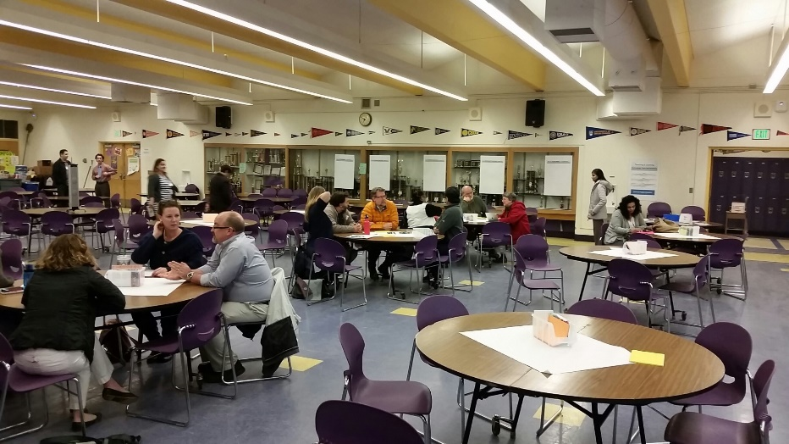
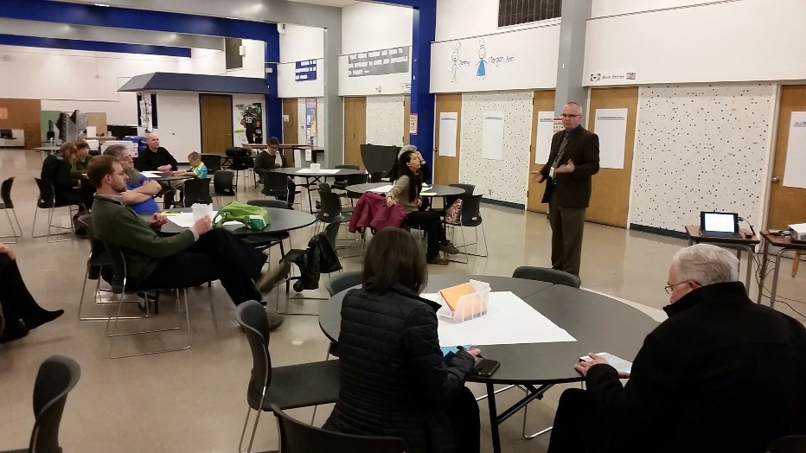
District-Wide “Town Hall Meetings”
Northeast
Southeast
Southwest
Central
Northwest

Slide 5
The Vision as a Video
Currently available in:
English
Somali (in final QA)
Coming Soon:
Spanish
Chinese
Vietnamese
Other Possible Languages:
Tagalog
Amharic
Tigrigna
Oromo
……… and much more!

Slide 6
2016-17 Computer Deployments (Southeast)
Phase 1 Schools | Allocation - # Devices | Tech Choices
Aki Kurose MS | 49 | 5 Dell Desktops, 51 Latitude Laptops, 1 Aver Cart, 1 iPad
Cleveland High School | 250 | 1 to 1 STEM Program
Dearborn Park | N/A | Current at-standard computer inventory exceeds 2.7:1 ratio
Dunlap Elementary | N/A | Current at-standard computer inventory exceeds 2.7:1 ratio
Hawthorne | 77 | 75 Dell Desktops, 2 Latitudes
Interagency | 169 | 150 Dell Desktops, 23 Latitudes
Kimball Elementary | 130 | 19 iMacs, 60 Latitudes, 86 iPads, 3 iPad Carts, 2 Aver Carts
Maple Elementary | N/A | Current at-standard computer inventory exceeds 2.7:1 ratio
MLK Elementary | 37 | 37 Dell Desktops
South Lake High School | 14 | 14 Dell Desktops
Phase 2 Schools | Allocation - # Devices | Tech Choices
Emerson Elementary | N/A | Current at-standard computer inventory exceeds 2.7:1 ratio
Beacon Hill
Graham Hill Elementary | N/A | Current at-standard computer inventory exceeds 2.7:1 ratio
Mercer MS | 246 | 30 Dell Desktops, 3 Mini-to-VGA Adapters, 3 SuperDrives, 3 macBook Pros, 222 Latitudes, 1 Bretford 16 Cart, 6 Aver 40 Carts, 31 iPads, 32 iPad Keyboards, 1 iPad Cart
Orca K-8 | 53 | TBD
OLD Van Asselt | 11 | TBD
Rainier Beach High School | 15 | 15 Dell Desktops
Rainier View Elementary | 48 | TBD
South Shore K-8 | 94 | TBD
Van Asselt @ AAA Elementary | 38 | 3 Dell Desktops, 30 Latitudes, 1 Aver Cart, 16 iPads, 4 iPad Keyboards
Wing Luke Elementary | 75 | TBD

Slide 7
2015 Computer Deployments (Southeast)
Southeast School | Type | Approximate number of classes taking SBAC in 2015 | Number of testing locations (labs+ mobile) | Carts added | Computers Added (32/cart)
Aki Kurose | M | 27 | 3 | 2 | 64
Beacon Hill | E | 10 | 1 | 1 | 32
Cleveland High School | H | 8 | 11 |  | 0
Dearborn Park | E | 7 | 1 | 1 | 32
Dunlap Elementary | E | 7 | 1 | 1 | 32
Emerson | E | 6 | 1 | 1 | 32
Graham Hill ES | E | 9 | 1 | 1 | 32
Hawthorne Elementary | E | 8 | 1 | 1 | 32
Interagency Academy | H |  |  |  | 0
Kimball | E | 10 | 1 | 1 | 32
Maple | E | 9 | 0 | 1 | 32
Martin Luther King, Jr. | E | 8 | 2 |  | 0
Mercer Middle School | M | 40 | 7 | 1 | 32
Orca | K8 | 14 | 2 | 1 | 32
Rainier Beach | H | 12 | 5 |  | 0
Rainier View | E | 10 | 1 | 1 | 32
South Lake | H | 4 | 1 |  | 0
South Shore K-8 | K8 | 18 | 5 |  | 0
Van Asselt | E | 11 | 2 | 1 | 32
Wing Luke Elementary | E | 6 | 1 | 1 | 32
 |  |  |  | 14 | 448

Slide 8
Main Topic: SPS’s Technology Vision for Teaching & Learning: Creating Equity Throughout the District
Discussion Question: What can the Department of Technology Services do to provide equitable access to technology, and ultimately equitable access to a quality learning experience, for all students across SPS and in the Southeast Region?
CREATING THE COMMON VISION:
The Teaching & Learning Technology Vision Summit and Town Hall Meetings (Quick Overview) 10 minutes
The Teaching & Learning Technology Vision: A Day in the Life of a 21st Century SPS Student (Video & Discussion) 10 minutes
QUESTIONS & DISCUSSION 10 minutes
SMALL GROUP ACTIVITY 20 minutes
What is the SESEC Vision for Technology in T&L?
How can DoTS help make the SESEC Vision a Reality?
WRAP-UP and NEXT STEPS 10 minutes

