Slide 1
Know Your Rights!
Steps to Prepare and Support
Immigrant, Refugee, and Other Communities
Notes:
Say who you are and what your job is within OneAmerica.
Interpreters – tell speakers to be mindful of any interpretation and to just go slow.
Questions – hold questions until the end of each section.

Slide 2
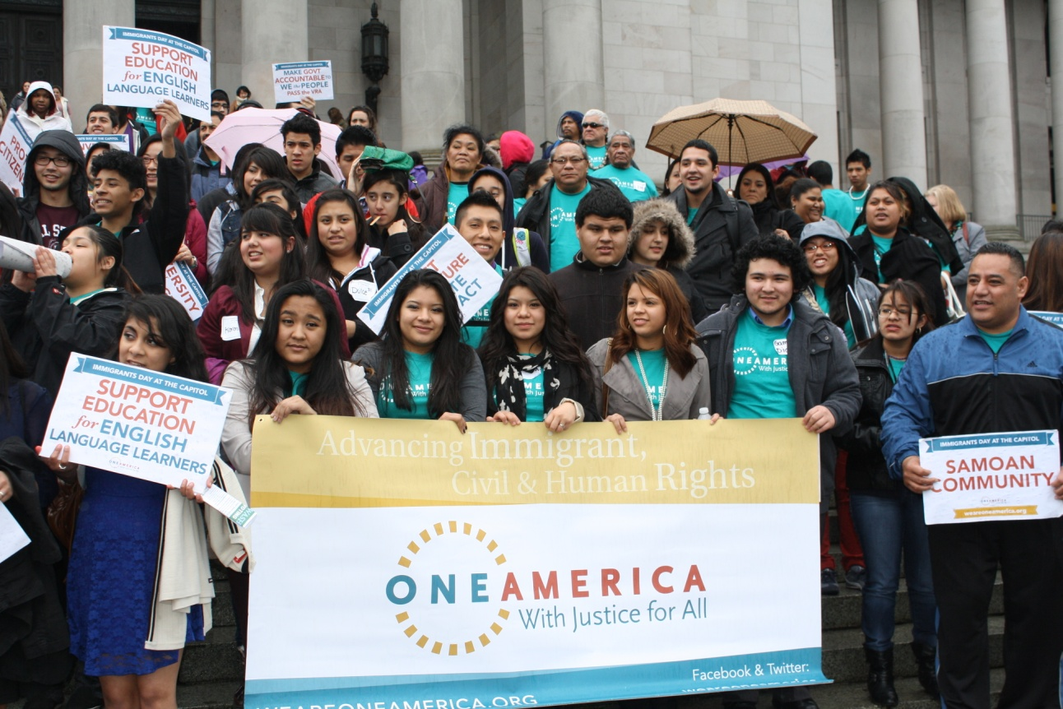
Who is OneAmerica? Advancing immigrant, civil, and human rights
Founded in 2001 in response to hate crimes after 9/11
Organizing Power: Building leadership in community groups across Washington
Policy Advocacy: Local, state and federal policy changes to improve opportunities for immigrants
Notes:
Important to say that we were founded in the wake of the 9/11 attacks, and we are entering a similar time, and need to stand up and make sure that we are protecting our communities against hate.
We organize immigrant communities around WA state with significant representation in South King County, Yakima, Mt. Vernon, and Vancouver. With over 1500 members statewide we build leadership and use this power to shift policies. Bridging grassroots power with grasstops advocacy makes us effective.

Slide 3
What We’ll Cover Today
1: Trump’s immigration announcements
2: Immigration information (DACA, Visa)
3: Your rights in the U.S. regardless of legal status
4: Making a safety plan
5: Reporting hate speech, hate crimes, and bullying
6: How to get involved
Notes:
Say that the presentation is split into 6 sections. We’ll go through each section and then ask questions about that section. Encourage people to write down their questions, think about which piece of the presentation their question links to, and ask it at the end of that section.

Slide 4
Introductions What are you hoping to learn today?
Notes:
This can be tailored depending on the size of the group.
Ideas: use a native talking stick with chairs arranged in a circle and ask each person to say their name & what other information?

Slide 5
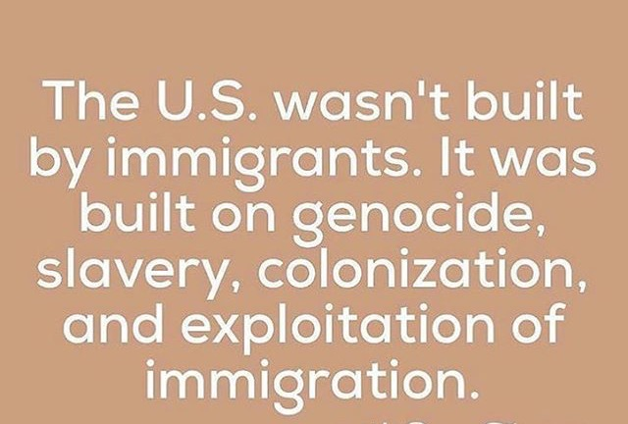
Honoring History
Notes:
Start by recognizing and honoring our collective struggles and triumphs
But to also be mindful the exploitation, erasure, and extraction of communities of color, as well as to critically examine the political, economic, and social Impacts of genocide, colonialism and slavery.

Slide 6
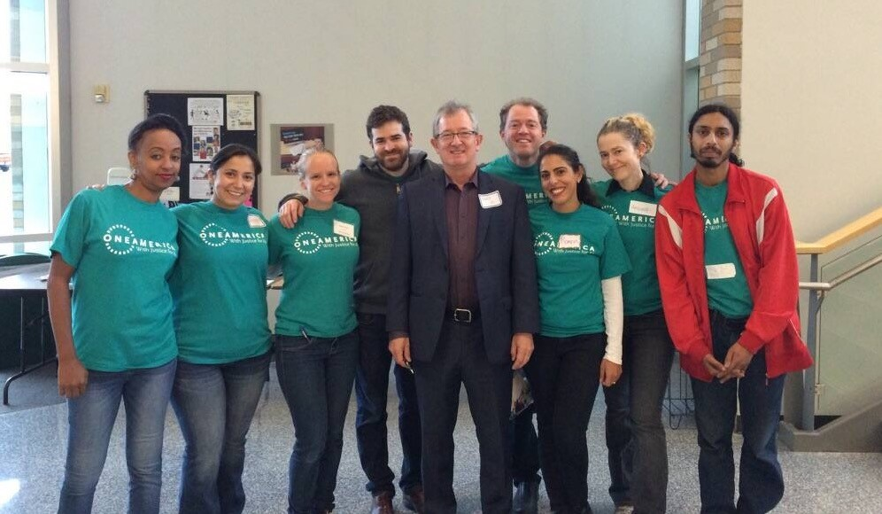
Reminders
We are not attorneys.
Information sharing
and movement building
Confidentiality
Language diversity
Take care of yourself.
Notes:
Emphasize that this is a safe space and explain what we’ll do with any shared information.

Slide 7
Trump’s Immigration Announcements

Slide 8
Executive Orders on Immigration
Interior immigration enforcement
Border security and immigration enforcement
Ban on refugee resettlement and on immigration from certain Muslim countries
Notes:
The executive orders announced by the new administration continue to criminalize and attack immigrant and refugee communities. The announcements raise serious due process concerns, jeopardize international relations, threaten U.S citizens, increase human rights violations and support the expansion of the prison-industrial complex.
EXECUTIVE ORDER: ENHANCING PUBLIC SAFETY IN THE INTERIOR OF THE UNITED STATES
At the crux of it all, the Trump Administration is calling for law enforcement officials to assist with the removal of everyone who has no immigration status, particularly if they have committed crimes or have final orders of removal. It remains unclear how the priority removal of every undocumented individual coincides with deferred action and DACA program, which currently remains in place, but may be rescinded.
This Executive Order mainly empowers law enforcement agencies to pursue the removal of all undocumented immigrants (without exception), non-citizens who are security risks, non-citizens with criminal convictions, and individuals with final orders of removal. It rescinds the Priority Enforcement Program (PEP), directs Immigration and Customs Enforcement to hire 10,000 officials to enforce the order, and restores the 287(g) program that allows local law enforcement to enforce immigration laws. The order also calls for actions to be taken against sanctuary cities and jurisdictions that refuse to comply with the enforcement of these laws, but these actions remain undefined (and arguably, unconstitutional).
EXECUTIVE ORDER: BORDER SECURITY AND IMMIGRATION ENFORCEMENT IMPROVEMENTS
Signed on January 25, 2017, this Executive Order calls for funding of a costly border between the U.S. and Mexico; curtails the due process of asylum seekers; calls for the detention of all persons attempting to enter the United States and all persons in removal proceedings; directs the Department of Homeland Security to immediately construct detention facilities at or near the southern border; limits the use of parole; expands the use of “expedited removal” to anyone in the United States who cannot prove s/he has lived here for at least two years; and prioritizes the criminal prosecution of unlawful entry into the United States. Recent guidelines issued by DHS also direct ICE to penalize parents who bring their undocumented children to the United States, and remove individuals with pending deportation cases to Mexico pending the conclusion of their cases.
EXECUTIVE ORDER: “PROTECTING THE NATION FROM FOREIGN TERRORIST ENTRY
The Trump Administration initially banned non-U.S. citizens from the seven countries above from traveling to the United States, hundreds of travelers were detained, and many had their visa interviews cancelled abroad. Green card holders from these countries were also interrogated at ports of entry around the country, despite assurances from the Trump Administration that this ban did not apply to them. Several courts issued injunctions against the executive order, and a federal court judge in Washington state stayed the travel ban (issued a temporary order to not execute the travel ban) as of February 3, 2017. In light of this court decision, citizens and nationals from Iran, Iraq, Yemen, Syria, Sudan, Libya and Somalia with non-immigrant visas, can once again, come back to the United States as their visas are no longer revoked, while the stay is in effect. Since the Ninth Circuit upheld the stay on the Executive Order, the Trump Administration has issued a new order to replace the initial one.
The Trump Administration has rolled out Muslim Ban 2.0, after a federal judge placed a stay on the travel ban impacting citizens and nationals of Iran, Iraq, Syria, Yemen, Libya, Somalia and Sudan. The new executive order was supposed to go into effect on March 16, 2017, and bans citizens and nationals of Iran, Syria, Yemen, Libya, Somalia, and Sudan from obtaining a visa to come to the U.S., with certain exceptions. However, a federal district judge has issued another stay on the roll-out of this visa ban.
http://undocu.berkeley.edu/fact-sheets-resources-trump-executive-actions-immigration/

Slide 9
Information about Immigration Status

Slide 10
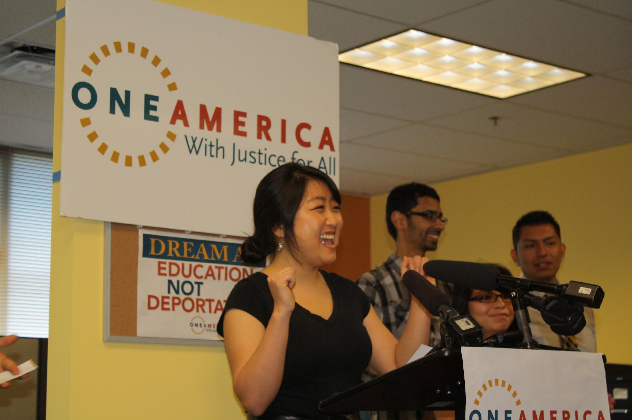
Deferred Action for Childhood Arrivals (DACA)
DO NOT begin a new application*
Renew application? Confirm with an immigration attorney first.
As of now, DACA recipients and undocumented students who meet the requirements still qualify for in-state tuition and state financial aid
Notes:
DACA is a program established by President Obama in 2012 that grants a form of temporary protection from deportation known as “deferred action” and provide work permits to undocumented individuals who:
came to the U.S. before the age of 16, have lived in the U.S. since June 15, 2007, were born on or after June 16, 1981, were in school, completed H.S., obtained their G.E.D., didn’t not disqualifying criminal offenses, and meet other requirements.
As of December 2016: Nationally: 770,000+ DACA recipients, in WA state: 17,551 DACA recipients
During the campaign, Donald Trump indicated that he would end the DACA program if he was elected, but he did not specify what this meant.
We believe that each individual should make their own decision after being informed of the risks and benefits, but provide these recommendations to those who have asked us for guidance.
Advice we’ve been hearing from partners:
If renewing and no issues (nothing has changed since you last applied), continue to renew DACA status;
If applying for the first time, consult with an immigration attorney about risks of applying
DACA is not a law, executive action.

Slide 11
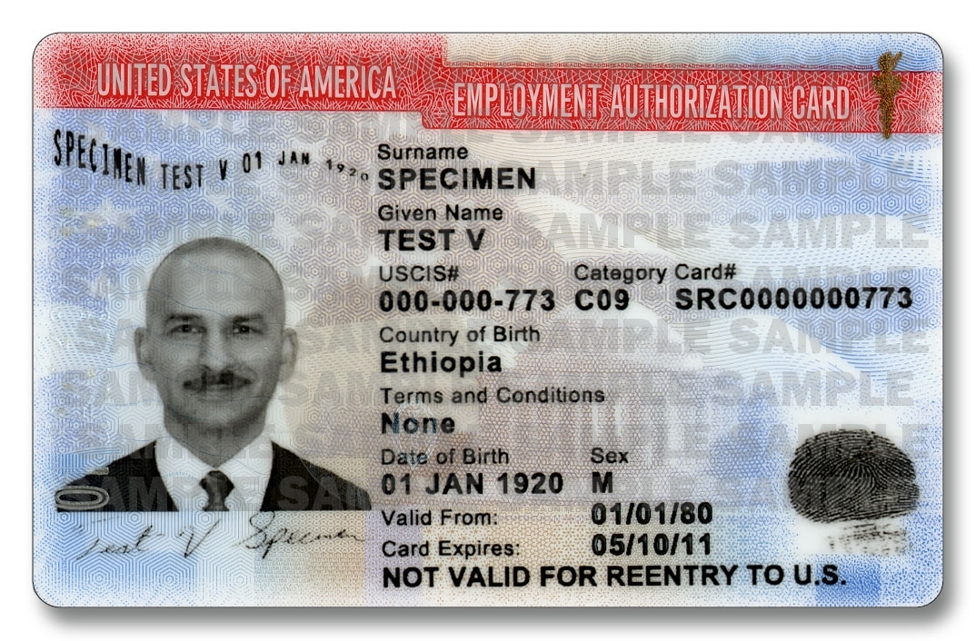
Immigration Status
Visa Green Card
Not yet a legal resident visa or work permit
Arrested / criminal record clear record
Consult an attorney for specific pathways for your status!
Notes:
If you have a visa, ask an attorney if you can apply for a Green Card.
If you are not a legal resident, ask an attorney if you are eligible for a visa or work permit.
If you have been arrested or have a criminal record, ask an attorney if there is a way to clear your record.

Slide 12
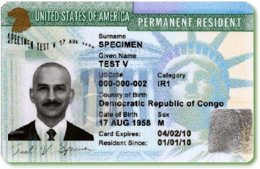
Green Card Holders
Citizenship is the only permanent protection from deportation.
Check eligibility
Consult with an attorney
http://www.wanewamericans.org/ or 1- 877-926-3924
Notes:
Consider applying to be a citizen soon -- citizenship is the only permanent protection from deportation.
Consult with an attorney.
The cost of the citizenship application increased to $725.
Fee waivers and free legal clinics! http://www.wanewamericans.org/ for free help or call 877-926-3924.

Slide 13
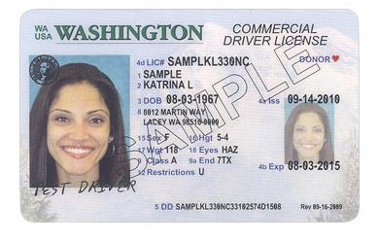
Driver’s Licenses
By January 2018, we anticipate some changes to the appearance of driver’s licenses in Washington state. But we do not anticipate any changes to eligibility for undocumented residents.
Notes:
Passed by Congress in 2005, the REAL ID Act enacted the 9/11 Commission’s recommendation that the Federal Government “set standards for the issuance of sources of identification, such as driver's licenses.” The Act established minimum security standards for state-issued driver’s licenses and identification cards, and prohibits Federal agencies from accepting for official purposes licenses and identification cards from states that do not meet these standards. States have made considerable progress in meeting this key recommendation of the 9/11 Commission and every state has a more secure driver’s license today than before the passage of the Act.
https://www.dhs.gov/real-id-public-faqs
Threat is that people won’t be able to travel domestically or use drivers ID to access federal buildings.

Slide 14
Know Your Rights:
Law Enforcement, CBP and ICE
Notes:
Alto Palimar

Slide 15
You are valuable to this community and if you are present in the U.S., you have constitutional rights regardless of immigration status
Notes:
Emphasize that no matter what your status, you still have rights.

Slide 16
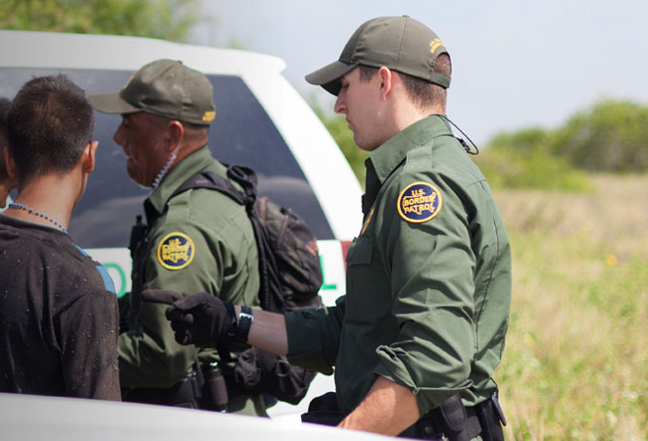
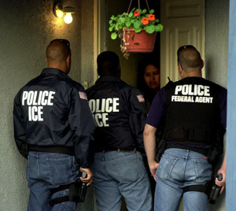
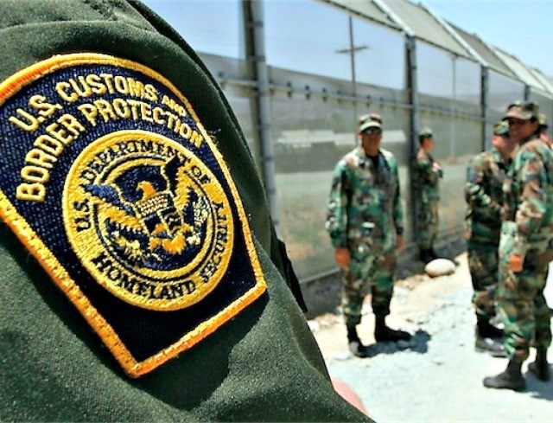
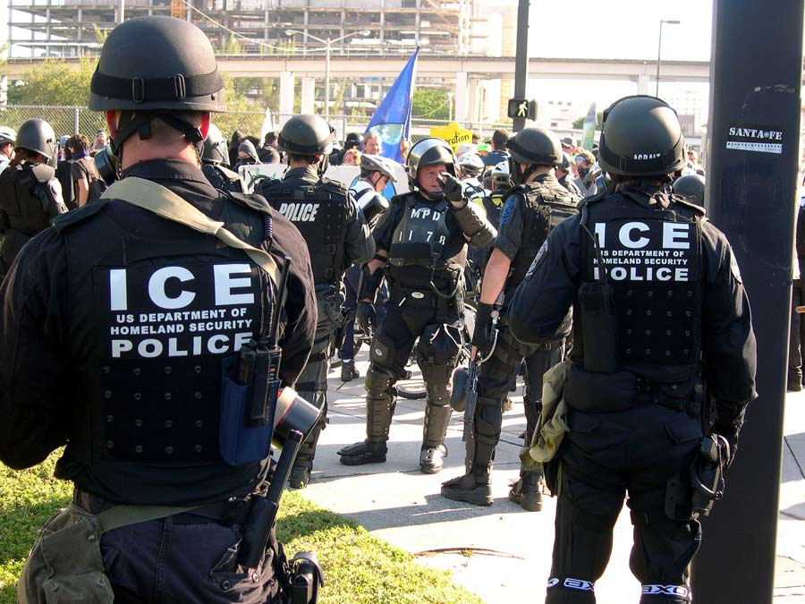
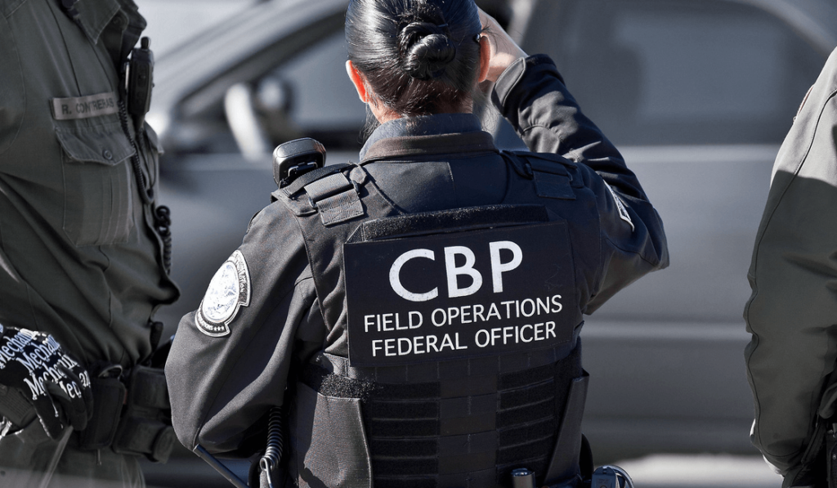
ICE
CBP
State Patrol
Local Law Enforcement
Notes:
Explain what the acronyms are:
ICE - Immigration and Customs Enforcement
CBP - Customs and Border Protection
ICE & CPB are the NOT the same as local law enforcement. But although they are not the same, they may work together.
What do these pictures have in common?
Have you seen or encountered people dressed like this in your community? Sometimes they are wearing plain clothing.

Slide 17
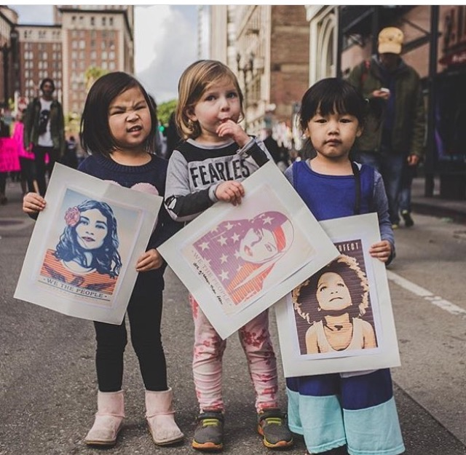
What are your rights if law enforcement or ICE
comes to your home?
DON’T OPEN THE DOOR
Tell your kids not to open the door.
Once inside they may expand their search.
Remind children not to answer or say anything.
Notes:
DO NOT OPEN THE DOOR: To be allowed to enter your home, ICE must have a warrant signed by a judge. Do not open your door unless an ICE agent shows you a warrant. (They almost never have one.) If an ICE agent wants to show you a warrant, they can hold it against a window or slide it under the door. To be valid, the warrant must have your name and address
Have people role play what to do if ICE come to the home, or if they try to talk to you in another location.
Tell the participants to practice these exercises with your family

Slide 18
If law enforcement or ICE asks to enter your home
Remember: You don’t have to say anything!
Remain Silent
Legal Representation
Don’t Sign Anything
They must have a warrant
Ask to see the warrant
Verfiy :
Correct name
Correct address
Must be valid :
Signed by a federal judge
Dated
Notes:
They must have a warrant (piece of paper that must be signed by a judge). It is very rare that they actually have the warrant.
You can ask an agent to hold the warrant against the window or slide under the door.
It must have your correct name and address.
Once inside, they may expand their search to others in the residence.
Remember: You don’t have to say anything, and if you choose not to, you can always request an attorney.

Slide 19
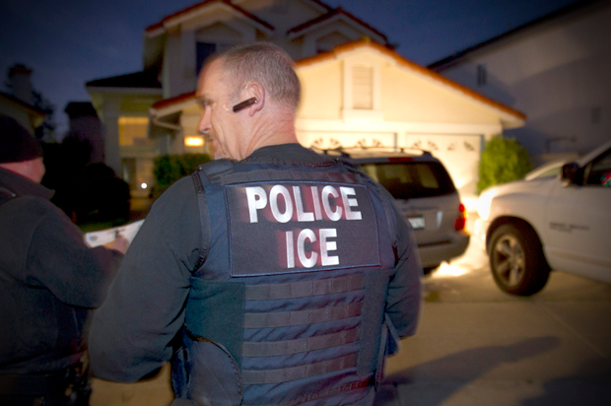
If you encounter ICE . . .
Remain Silent Don’t say where you were born. Don’t discuss status.
Legal Representation Don’t answer questions. Refuse to show documents without lawyer.
Don’t Sign Anything Right to make phone call and speak with your attorney
Notes:
For example, if you encounter ICE walking down the street or coming out of school….
If you are undocumented,
No matter what don’t say where you were born. They will harrass you.
In any situation you HAVE THESE RIGHTS!
In those situations it can be really scary, and even if we know our rights.

Slide 20
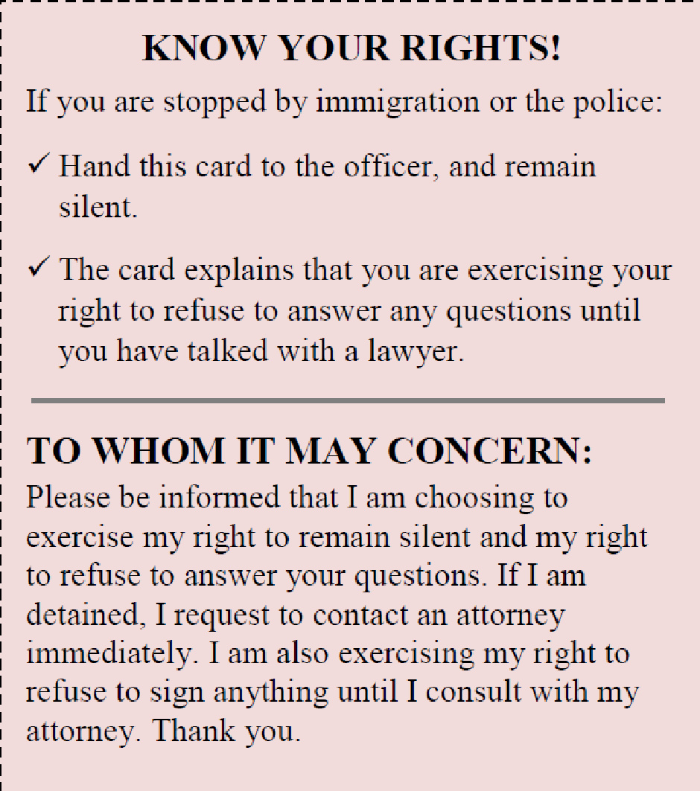
Carry a ‘Know Your Rights Card’ and present it if
Law Enforcement or ICE stops you
The card explains that you will remain silent and that you wish to speak with an attorney.
Notes:
Cards are located in back of rooms
Carry this card with you and hand it to the officer if they try to talk to you.

Slide 21
For Community Members with Citizenship or Legal Permanent Residency Status
Carry copies of primary documents that demonstrate your status.
Be prepared to show ICE or law enforcement officers your documentation if they ask.
Know that you have the right to: 1. Remain Silent
2. An Attorney

Slide 22
Again, if you do not have legal documentation:
If confronted by ICE, REMAIN SILENT, say you have the right to speak with an ATTORNEY, give them your RED CARD.
DO NOT OPEN THE DOOR to your home for ICE.

Slide 23
Impacts of ICE Raids on Children
Research consistently shows a harmful impact on health, safety, academic performance, and overall well-being of children.
Children witnessing ICE raids are more likely to suffer PTSD than those witnessing arrests in other settings.
Some symptoms include changes in sleeping and eating patterns, higher levels of fear and/or anxiety, behavior changes, and absenteeism.

Slide 24
Key Things to Remember
ICE is not your friend.
Don't talk about your country of origin.
Don’t carry documents from your country of origin.
Don’t run.
Remember that everyone has a right to go before an immigration judge.
Prepare your family!

Slide 25
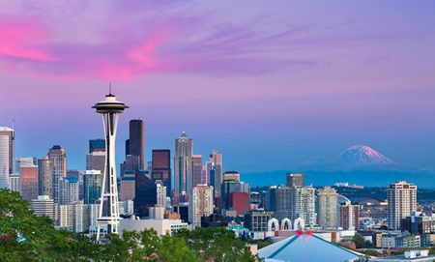
Sanctuary Spaces
Sanctuary policies DO NOT prohibit ICE from operating.
They DO send a strong message of resistance and welcome.
They also mean that:
The City of Seattle will not actively collaborate with ICE.
In King County, jails will not hold people to be picked up by ICE.
Statement of Protection Sign On Letter : https://actionnetwork.org/petitions/statement-of-protection?clear_id=true

Slide 26
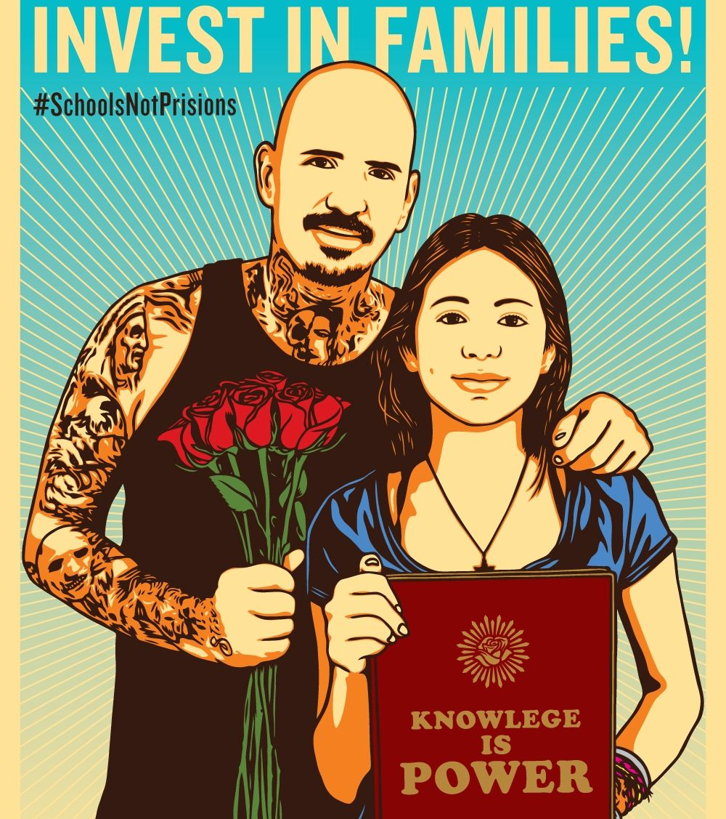
Education Rights
Students under 18 have a right to a free and equal education regardless of immigration status.
Schools cannot ask about the immigrant status of parents or student.
Any information gathered about a student cannot be voluntarily shared with an outside agency.
Notes:
https://www.ilrc.org/sites/default/files/resources/schools_post-election-v4.pdf
http://www2.ed.gov/about/overview/focus/supporting-undocumented-youth.pdf
Caveat to 3rd bullet point: If an agency requests particular information, then schools may have to give it to them.

Slide 27
School Safety
Sensitive Locations: schools, early learning settings, hospitals, demonstrations, and places of worship
For ICE to take action, they must have permission from a supervisory official or it must be an urgent situation.
Notes:
Schools cannot ask if you are undocumented or not. Though it is unlikely that immigration enforcement would come to a school or church, that does not mean that they can’t go there.
https://www.ilrc.org/sites/default/files/resources/schools_post-election-v4.pdf
http://www2.ed.gov/about/overview/focus/supporting-undocumented-youth.pdf

Slide 28
Early Learning: What We Know
Rights
• 2011 ICE Memo: “Sensitive Locations” – pre-schools and learning sites
- Unless prior approval is obtained
• Children, regardless of status, have a legal right to K-12 education; mixed-status families may qualify for childcare programs like:
- ECEAP
- Working Connections ChildCare
Workforce
• WA Dept of Early Learning allows undocumented providers to obtain licenses to work; scholarship dollars are also available to support them.
• Degree seekers using DEL scholarships are not required to disclose status to their campus.
• DEL is figuring out how and what they can do to protect providers and families.

Slide 29
What You Can Do to Support Kids & Families
Safety Plans
• Provide resources for families to make a safety plan.
• Make sure emergency contacts are updated. Each contact should be a citizen who can keep kids in trusted, safe care.
Important to Know!
• Federal law (FERPA) prohibits educational institutions from sharing information about families and students.
Talk to families, reassure them, and connect them to resources

Slide 30
What Does This Mean?
We prepare.
We get and share information
Seek legal advice
Create safety plans
Learn and exercise our rights
We do all this for ourselves and our communities. We make it accessible. We make a commitment to organize.
Notes:
Arte: Melanie Cervantes

Slide 31
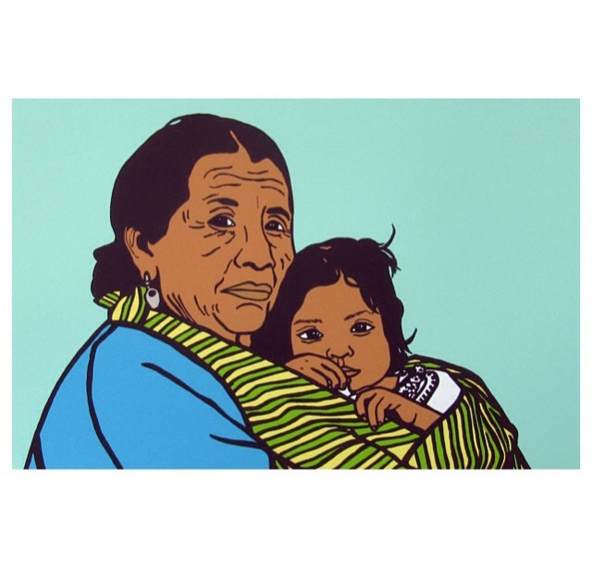
Making a
Safety Plan

Slide 32
The Best Safety Plan is:
_______________________________________
Notes:
As for suggestions from participants

Slide 33
Plan With Your Family and Friends
Memorize the name and phone number of a friend, family member and your attorney whom you can call if arrested or detained.
If you take care of children or other people, make a plan to have them taken care of if you are detained. Specify the plan for legal custody should you be detained or deported.
Keep important documents such as birth certificates and immigration documents in a safe place where close friends/family know they can access them. It’s also important to have copies.
Make sure your loved ones know how to use the ICE online detainee locator to find who is in immigration custody: https://locator.ice.gov/odls/homePage.do . Make sure someone has your alien registration # to look this up.
Update your children’s emergency contact information at their school.
Notes:
Add context that this is very sensitive information.
- Have people start to write these things down on a sheet.
- Only share and develop this safety plan with trusted family or friends.
- Ask, “How many people know the phone number of your spouse?”
- Documents to add:
- For asylum seekers, documents that show that you are in danger or at risk in your home country
- Letters of support (community service, churches, places you belong)
- Practice the safety plan with your family members. Put it on your fridge.

Slide 34
List of Documents to Compile in a Safe Place
Birth certificates and ID documents
School records
Employment records
Tax returns
Proof of presence with address
Evidence of risk in your country
Letters of support
Criminal / court records
Notes:
Emphasize that this is the list of what to prepare in case anything happens to you, as opposed to the documents you should carry with you. Be clear with everyone that this list is for folks to begin compiling and keeping in a safe place, not to have on their person.

Slide 35
Find Legal Help
ALWAYS consult an attorney.
We have a list of trusted attorneys and web sites to search for free and low-cost attorneys.
Be careful to use only trusted attorneys, and ask how fees are set.
Notes:
Ask how fees are set and what they include.
Lawyers should always be willing to explain.
Use your instinct.
Make sure that the lawyer is licensed to practice in the state of Washington.
Immigration law is very complicated.

Slide 36
Create a Financial Plan
Save money.
Confirm who has access to your bank account.
Confirm who would be in charge of selling your possessions.
Confirm who knows your Social Security or ITIN number.
Notes:
Opportunity to partner with other orgs that do free financial workshops, such as Neighborhood House, etc.

Slide 37
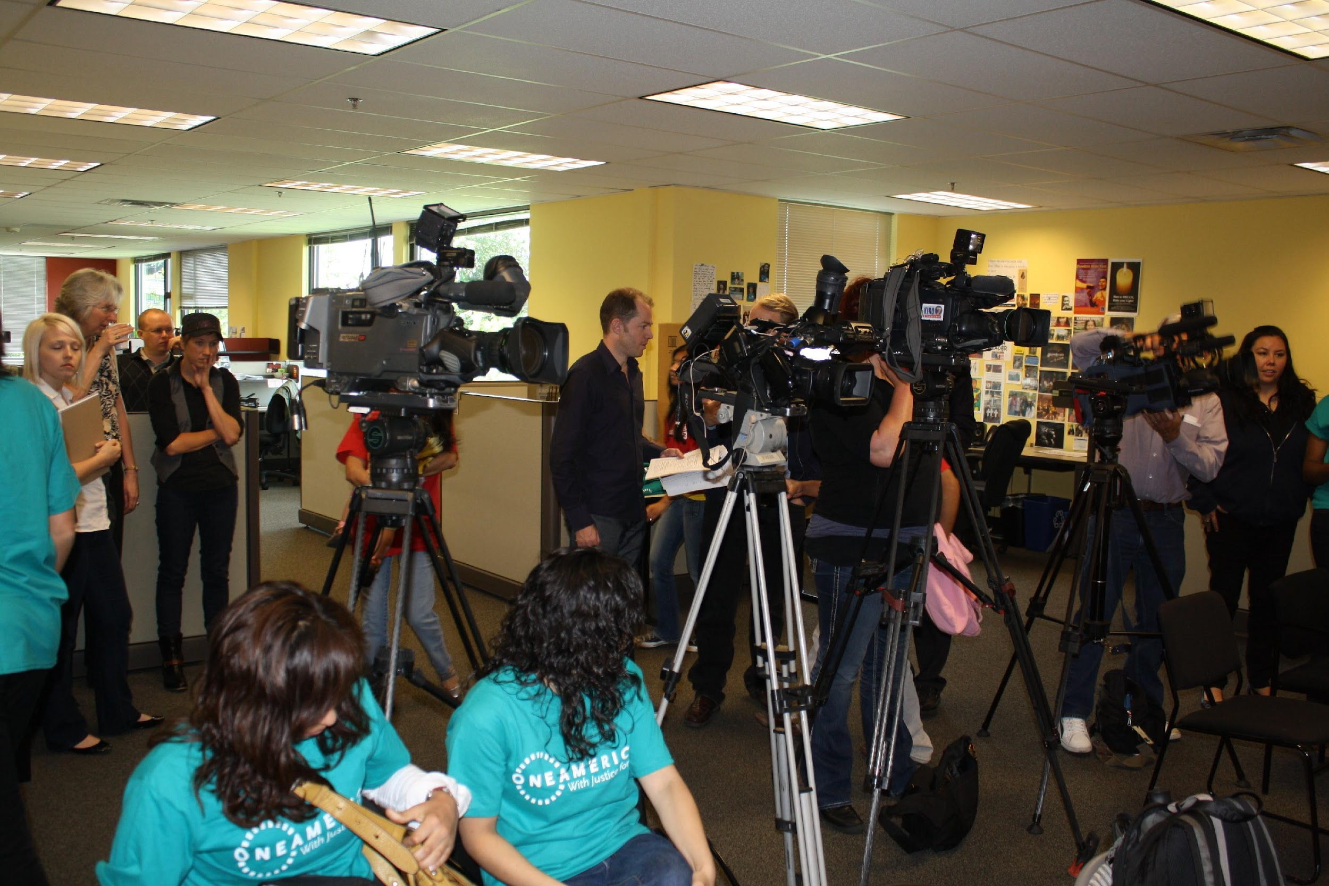
Report and Document Raids and Arrests
Record and Document
Get information on: Who, What, When, Where.
REPORT
To report immigration activity in Washington: Dial 1-844-RAID-REP
(1-844-724-3737)
Notes:
The Washington Immigrant Solidarity Network launched a hotline to report detentions and other immigration activityies. The reporting hotline launched on Monday, May 8th and will allow people to report situations in which community members have been detained by immigration agents anywhere in Washington, to a live hotline volunteer 7 days a week, between 6am – 9pm
The hotline will allow people to report when loved ones or friends have been detained by immigration agents or other instances of problematic behavior conducted by immigration officials. When someone calls the hotline, volunteers will ask questions about the incident to collect as much information as possible, including: what did the agents uniforms look like? What markings were on the vehicles? Callers will also be provided with information regarding resources avaialble to those individuals detained by ICE or Border Patrol agents.
The hotline is one of many rapid response tols that the Washington Immigrant Solidarity Network is developing. Others include a text message alert system, a phone app, and on the ground training for community preparedness and rapid response.
When taking photos or videos, be very careful and make sure your safety is not at risk, especially if you do not have legal permanent residence that you are not putting yourself at risk.
You can also call United We Dream’s Hotline to Report a Raid: 1.844.363.1423

Slide 38
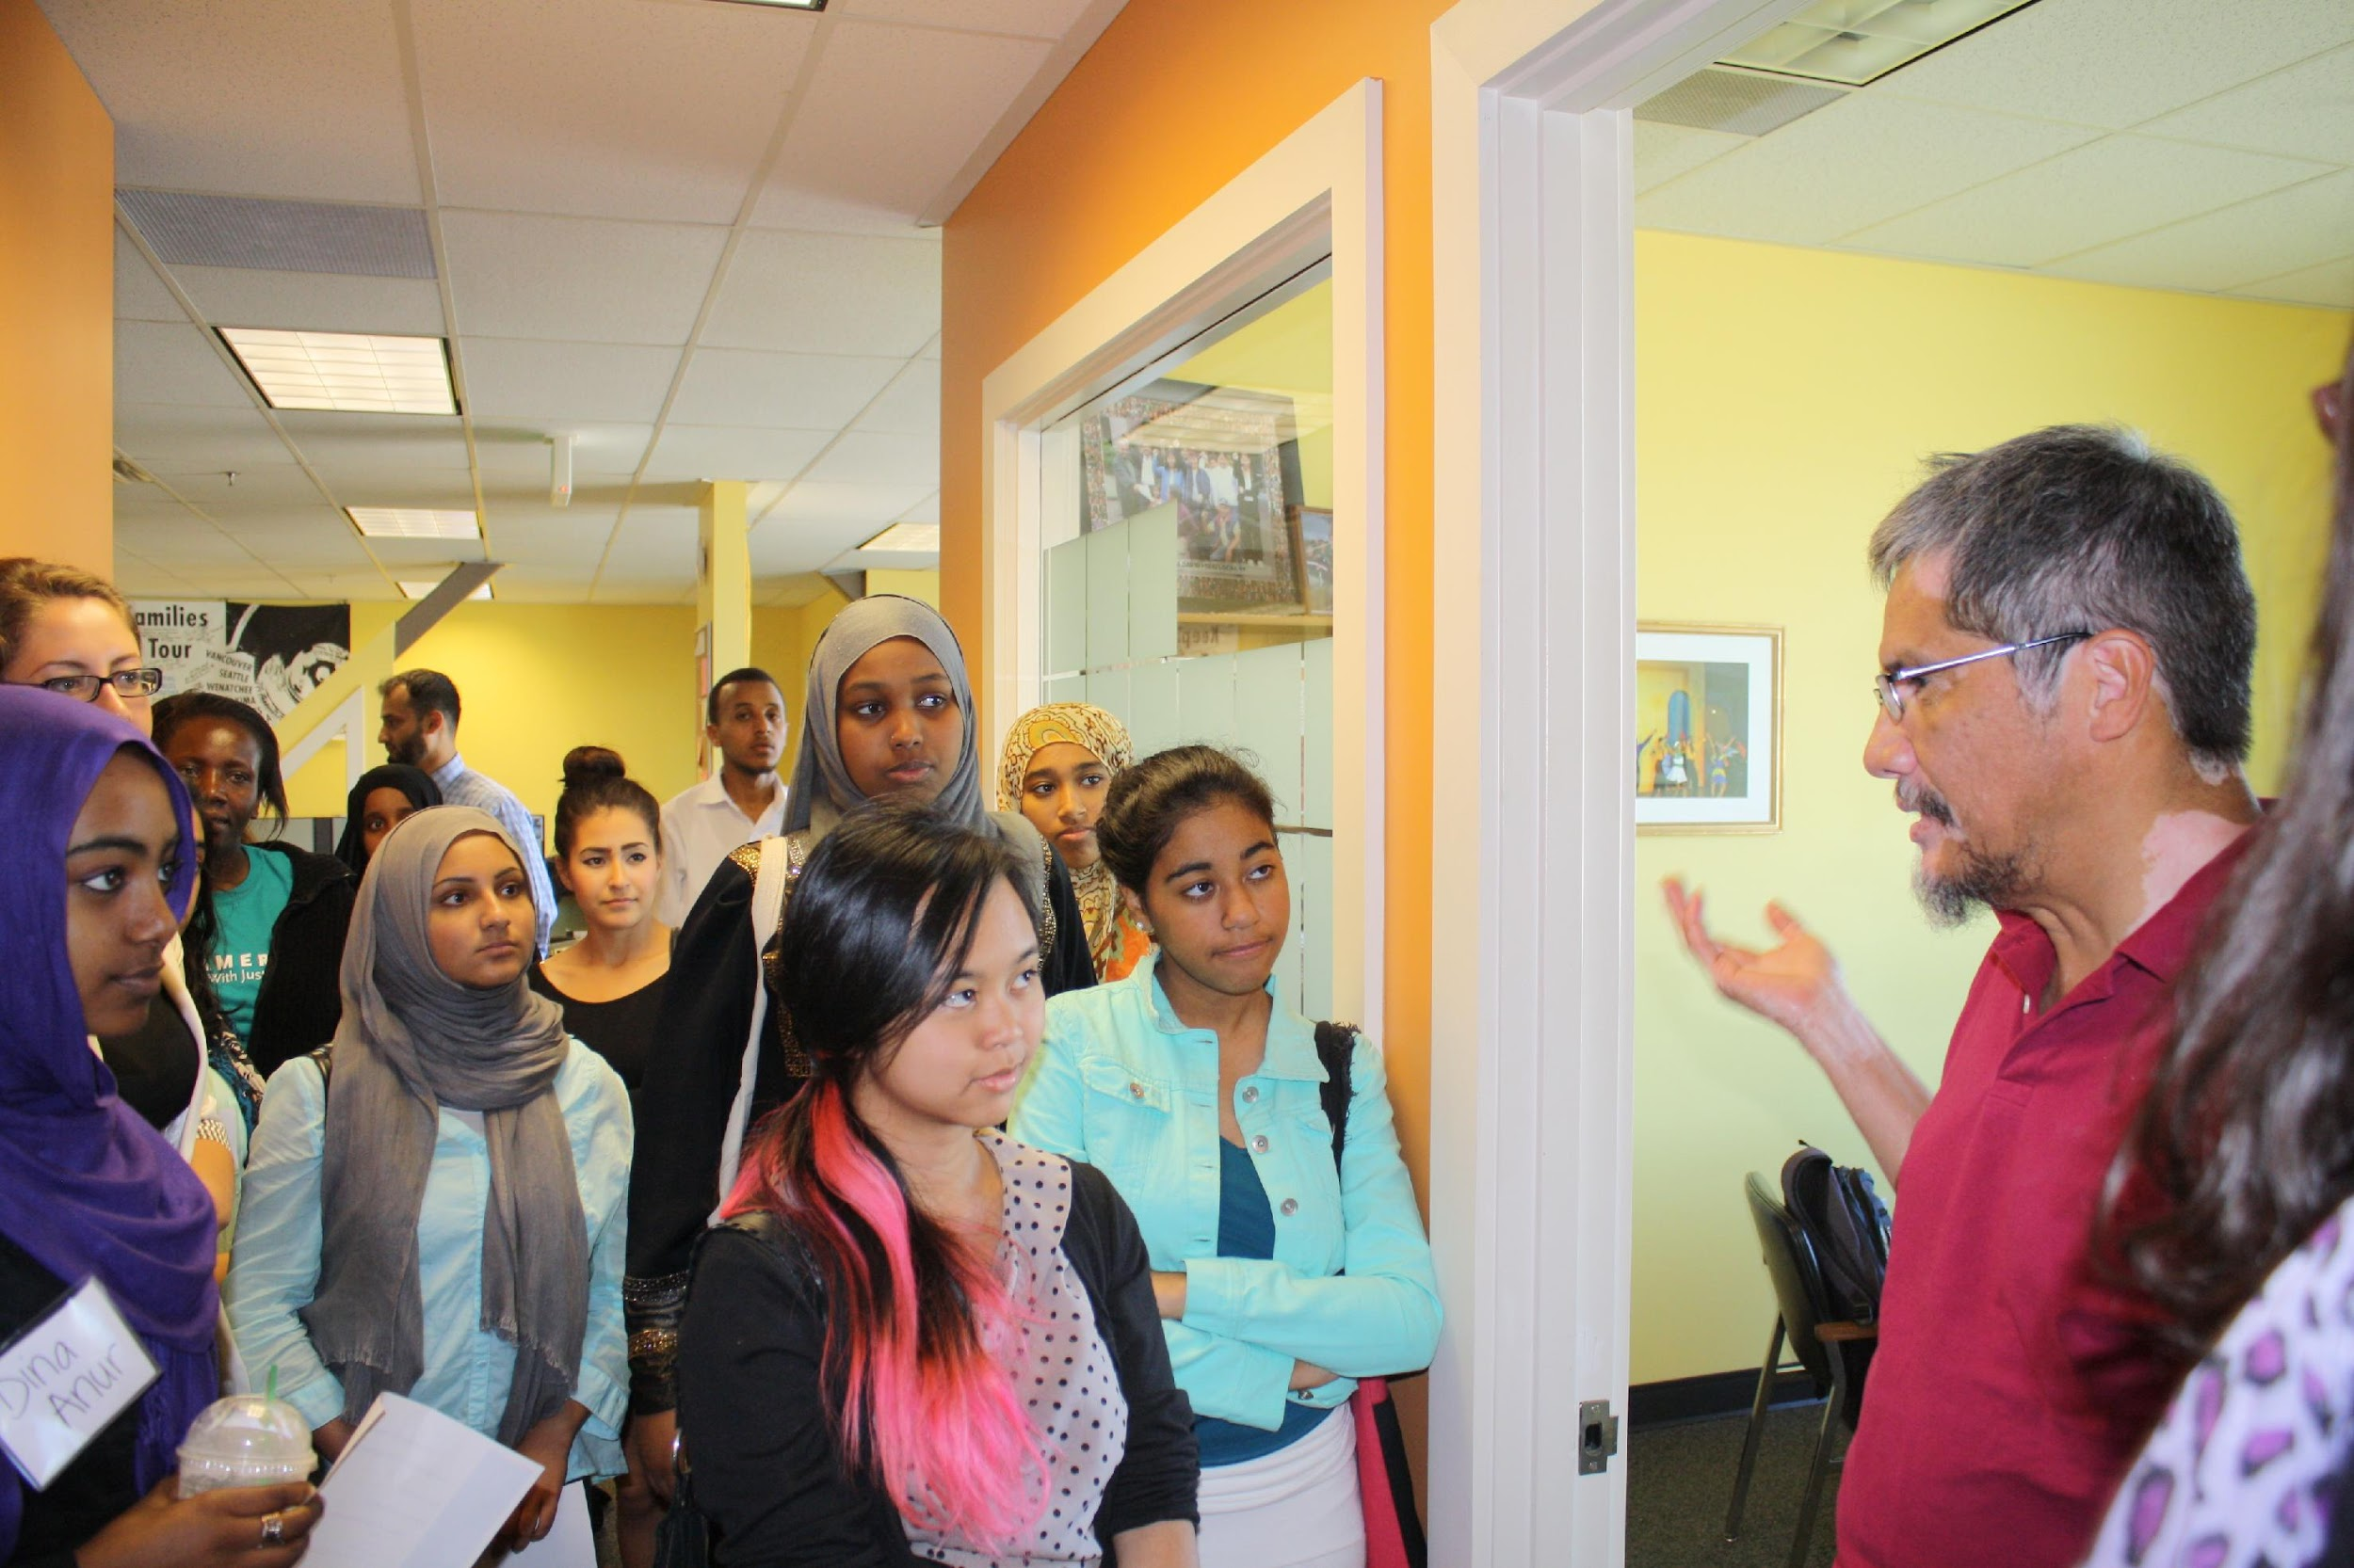
Hate Crimes,
Hate Speech, and Bullying
Notes:
Ask: How many people here are parents?

Slide 39
Given the current political climate, there has been an increase in hate crimes and hate speech against immigrants, Muslims, Sikhs, Middle Easterners, people of color, LGBTQ individuals, and others.
Notes:
Acknowledge that there has already been an upsurge in hate crimes.

Slide 40
What are hate crimes, hate speech, and bullying?
Hate Crime
Violence of intolerance and bigotry, intended to hurt and intimidate someone because of their race, ethnicity, national origin, religion, sexual orientation, or disability (according to the U.S. Justice Department)
Hate Speech
Speech that offends, threatens, or insults groups based on race, color, religion, national origin, sexual orientation, disability, or other traits (according the the American Bar Association)
Bullying
Unwanted, repeated aggression where a person who has more power, or thinks they have more power, attacks another person . Often this happens in schools to youth.
Notes:
http://ejce.berkeley.edu/report-incident/what-hate-crime#hatecrime
You are attacked or targeted because of your identity.
Hate speech often leads to hate crimes, and these two things are connected. We cannot tolerate either of them.

Slide 41
How do I know if it is happening?
Where does it happen?
At work
At school
In the street
On public transportation
On your property (for example, graffiti or damage
How do I know if someone is impacted?
Unexplained injuries, headaches or stomachaches
Change of eating or sleeping habits
Feeling hopeless
Avoiding social situations
Practicing self-harm, running away, or other self-destructive behavior
Notes:
Start with: “Sometimes it can be hard to know if your family members or friends are experiencing any of this. These are some ways that can help identify …”
Where does it happen?
At work, at school, on the street, on public transportation, or on your property
https://www.stopbullying.gov/at-risk/warning-signs/
http://ejce.berkeley.edu/report-incident/what-hate-crime#hatecrime

Slide 42
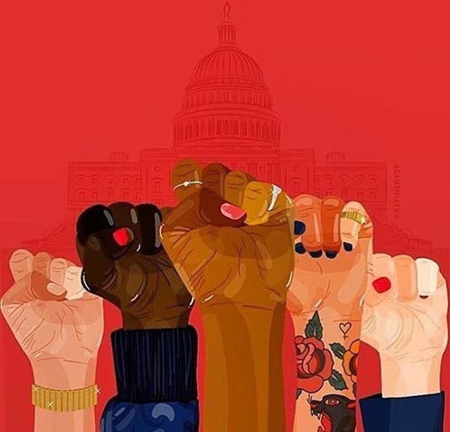
How to report a hate crime
Document and Record
Take photos and video.
Document: who, what, when, where, and how.
Get contact information of witnesses.
Report
If there was violence, call 911 (local police).
Hate crime / hate speech : Southern Poverty Law Center https://www.splcenter.org/contact-us
Hate speech / hate crime against Muslims : Council on American-Islamic Relations (CAIR) 206-367-4081 or http://cairseattle.org/get-help
In a school: report it to the school or to the ACLU, 206-624-2184.
Notes:
Document the time and place, who did it to whom, description of what happened.
If violence, call 911.
If hate speech or a hate crime, report to Southern Poverty Law Center https://www.splcenter.org/contact-us
If hate speech or a hate crime against Muslims, or those perceived to be Muslim, report to the Council on American-Islamic Relations (CAIR): 206-367-4081 or http://cairseattle.org/get-help
The ACLU of WA is not collecting information in general on hate crimes/harassment, but is collecting information about any harassment or bullying that takes place in public schools.
We will include a sheet on what to document, how to document.

Slide 43
How Do I Support Someone Who Has Experienced a Hate Crime, Hate Speech or Bullying?
Be present with them.
Ask and listen .
Reassure.
Show your support.
Tell them that the violence that they experienced was not their fault.
If they want, help them report the incident, get medical care, talk with a counselor, and find resources.
Notes:
http://ejce.berkeley.edu/report-incident/what-hate-crime#hatecrime

Slide 44
Let's Review
If ICE is at your door, you . . .
If you are detained by ICE, you have the right to …
Remain _____________.
Talk to an ________________.
__________ sign anything.
The best safety plan is: _____________________.
Raid / hate crime, I: ___________________________ .
With my kids, I will: _____________________________________________________.

Slide 45
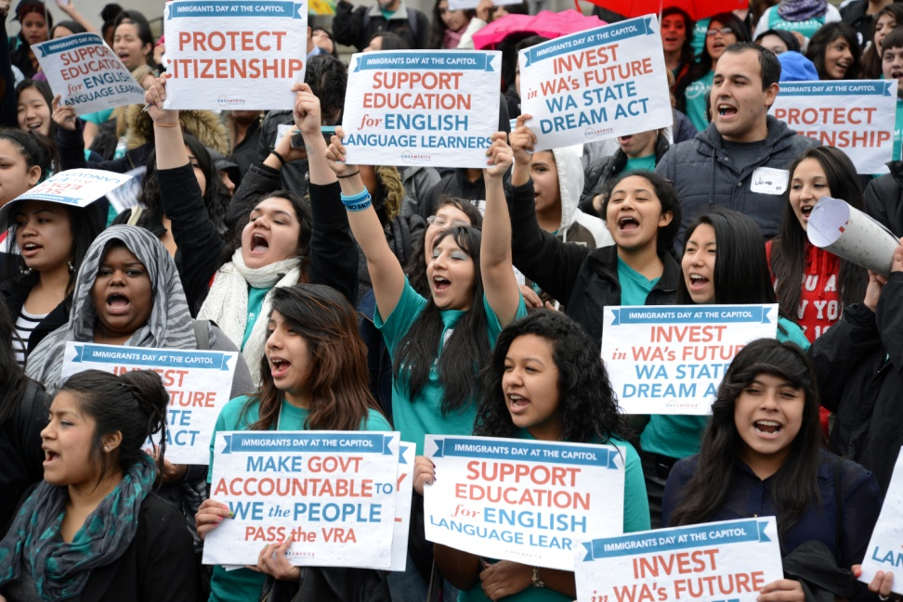
How To Get Involved
Come to a OneAmerica base group meeting to build your leadership and join the movement for justice.
Get trained in how to facilitate these sessions for your community.
Advocate to keep Washington and your county, city, and school district welcoming for immigrants, refugees, and other communities.
Notes:
Opportunity to build our base and bring more people into the movement

Slide 46
IN CLOSING: What’s one commitment you will make today to stand up for immigrants, refugees, communities of color, and other communities?
Notes:
http://www.ncpc.org/topics/hate-crime/strategies

Slide 47
QUESTIONS?
Notes:
Attorneys

Slide 48
CONTACT US
Nimco Bulale nimco@weareoneamerica.org

Slide 49
THANK YOU !

