Slide 1

Bolstering Advocacy:
Using Racial and Ethnic Data in the Community Engagement
Southeast Seattle Education Coalition (SESEC)
Bach Mai Dolly Nguyen
January 18, 2018

Slide 2
Washington State Race and Ethnicity
Student Data Task Force (RESD)
Fourth Substitute House Bill 1541 (4SHB 1541)
  Further disaggregate Black category
  Further disaggregate Asian category
  Further disaggregate White to include Eastern Europeans
  Collect racial and ethnic combinations for multiracial students
Task force represented by community members/leaders, ethnic commission representatives, parents, and education advocates
Provide recommendations to EOGOAC regarding racial/ethnic categorical changes

Slide 3
Data Collection Process
Schools and districts collects student data.
Districts report student data to the OSPI
OSPI compiles state level data.
OSPI reports data to the U.S. Department of Education.
The U.S. Department of Education complies national-level data.

Slide 4
WHY DOES DATA DISAGGREGATION MATTER?
Notes:
AAPIs have a long history and presence in the state and they continue to be important as their population steadily increases in size and proportion. AAPIs are the second largest racial group to Latinos. Washington has the 7th largest population of Asians Americans and the 3rd largest population of NHPIs. These numbers translate into the educational enrollment from K-12 to higher education.

Slide 5
Degree Attainment – Bachelor’s or Higher among Latino Ethnic Subgroups, 25 years old and older
SOURCE: ACS, 2011-2013.
Notes:
DOLLY

Slide 6
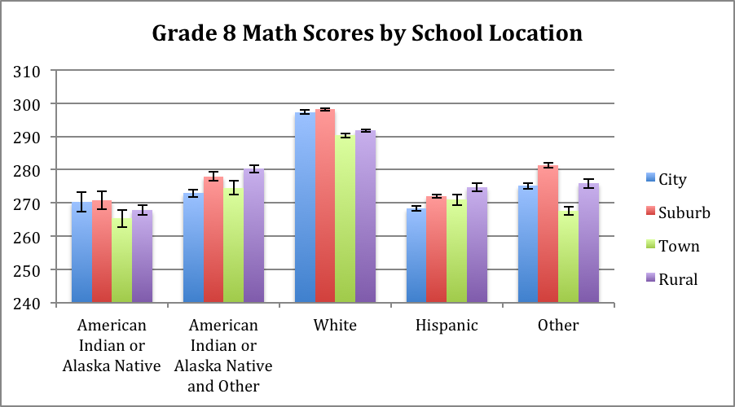
Grade 8 Math Scores by School Location
SOURCE: Brady, Strong, & Fryberg, 2016.
Notes:
DOLLY

Slide 7
Nation of Origin and Population of Black Immigrants in U.S.
AFRICA |  |  | CARIBBEAN
Nation of Origin | % Black Immigrant Population | Population in Thousands | Nation of Origin | % Black Immigrant Population | Population in Thousands
Nigeria | 6% | 226 | Jamaica | 18% | 682
Ethiopia | 5% | 191 | Haiti | 15% | 586
Ghana | 4% | 147 | Trinidad & Tobago | 5% | 192
Kenya | 3% | 107 | Dominican Republic | 4% | 161
Liberia | 2% | 83 | Barbados | 1% | 51
SOURCE: Anderson, 2015.
Notes:
DOLLY

Slide 8
WHY IS THIS RELEVANT TO COMMUNITY LEADERS?
Notes:
AAPIs have a long history and presence in the state and they continue to be important as their population steadily increases in size and proportion. AAPIs are the second largest racial group to Latinos. Washington has the 7th largest population of Asians Americans and the 3rd largest population of NHPIs. These numbers translate into the educational enrollment from K-12 to higher education.

Slide 9
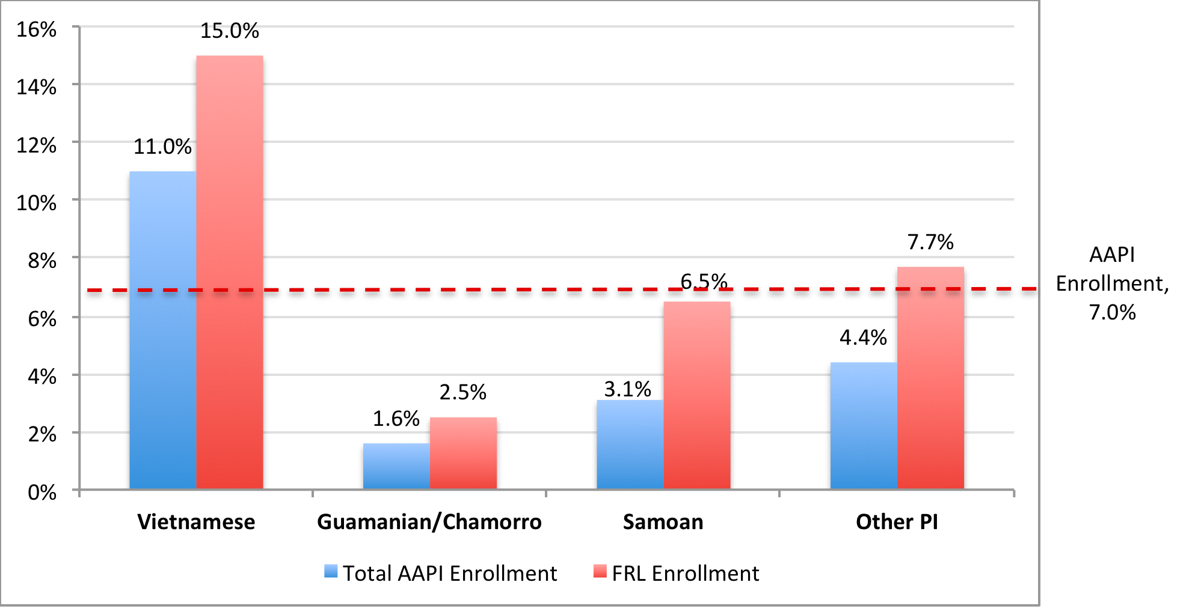
Representation of Ethnic Subgroups in Total Enrollment and Free or Reduced Lunch Utilization among AAPIs
SOURCE: OSPI Enrollment Data, 2013.
Notes:
DOLLY

Slide 10
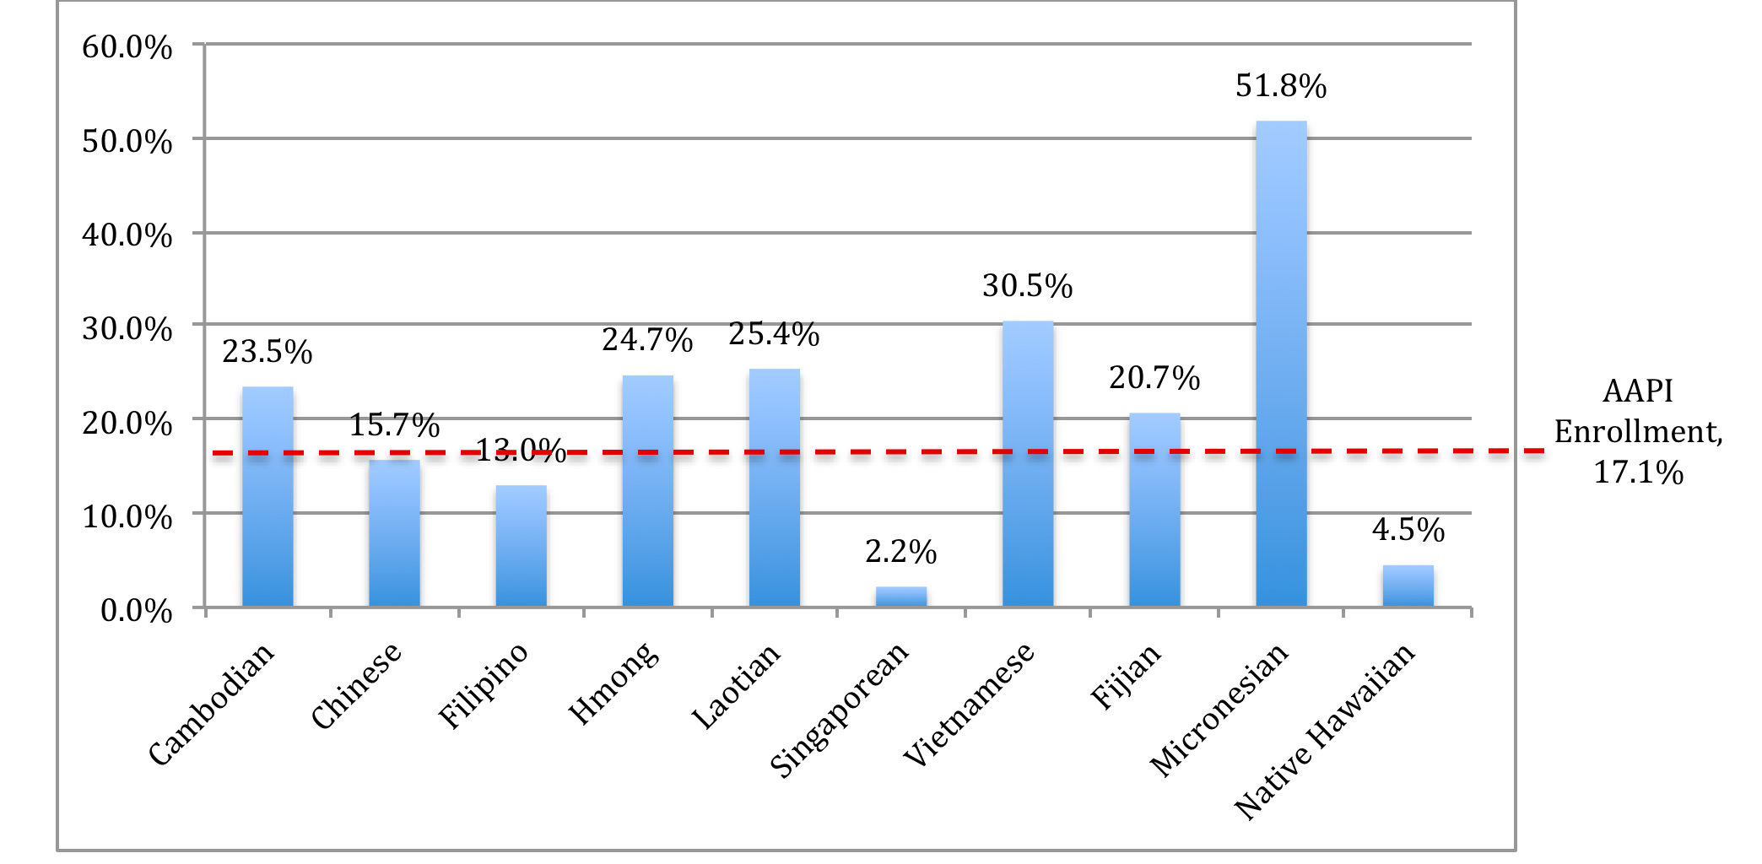
Representation of Ethnic Subgroups in Total Enrollment Bilingual Education Enrollment among AAPIs
SOURCE: OSPI Enrollment Data, 2013.
Notes:
DOLLY

Slide 11
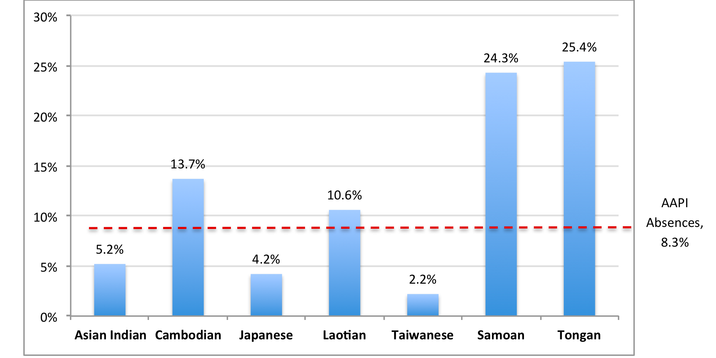
Five or More Unexcused School Absences
by AAPI Subgroups
SOURCE: OSPI Enrollment Data, 2013.
Notes:
DOLLY

Slide 12
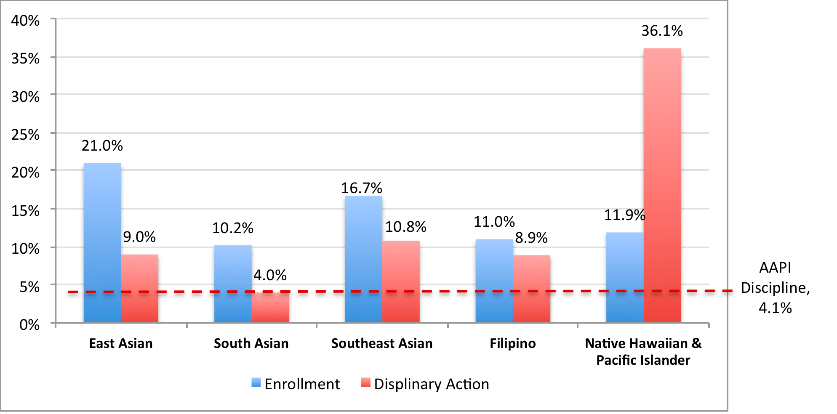
Disciplinary Action by AAPI Regional Groups
SOURCE: OSPI Enrollment Data, 2013.
Notes:
DOLLY

Slide 13
Proportional Representation in K-12 and College Enrollment
by AAPI Regional Groups
SOURCE: U.S. Census Bureau, American Community Survey, 1-Year Estimates, 2013; ERDC Postsecondary Enrollment Data, 2013.
Notes:
DOLLY

Slide 14
Proportional Representation in K-12 and College Enrollment
by AAPI Subgroups
SOURCE: U.S. Census Bureau, American Community Survey, 1-Year Estimates, 2013; ERDC Postsecondary Enrollment Data, 2013.
Notes:
DOLLY

Slide 15
HOW IS DATA GOING TO CHANGE?

Slide 16
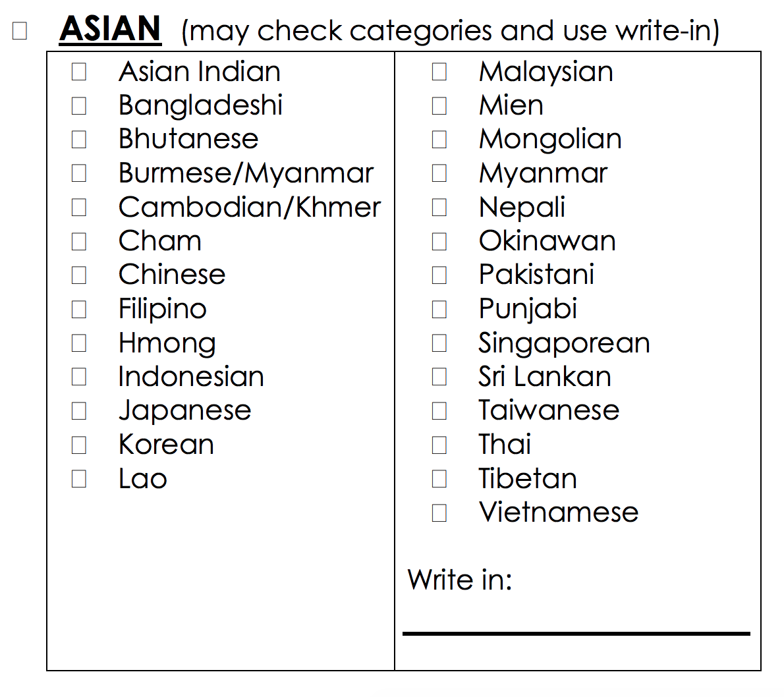
Drafted Data Changes for Asian Category
Notes:
DOLLY

Slide 17
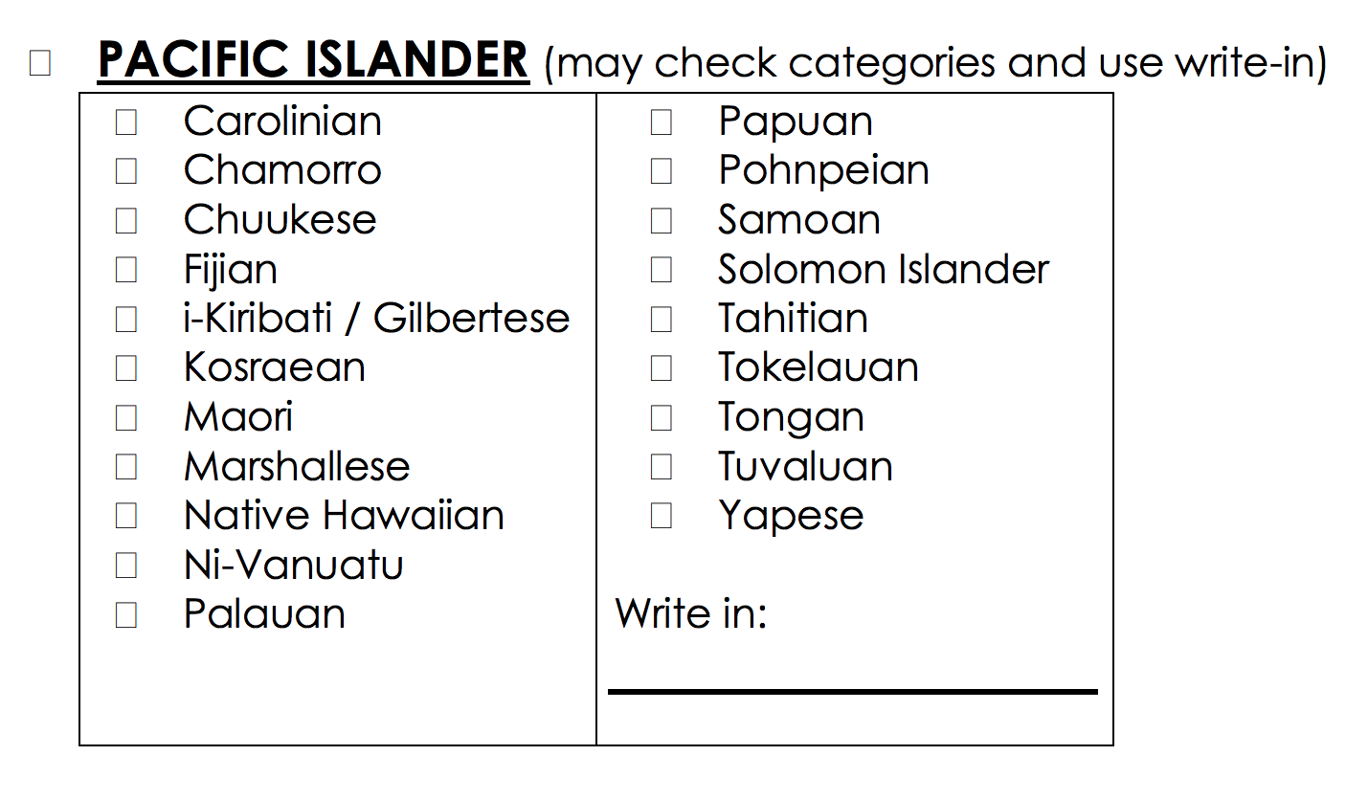
Drafted Data Changes for Pacific Islander Category
Notes:
DOLLY

Slide 18
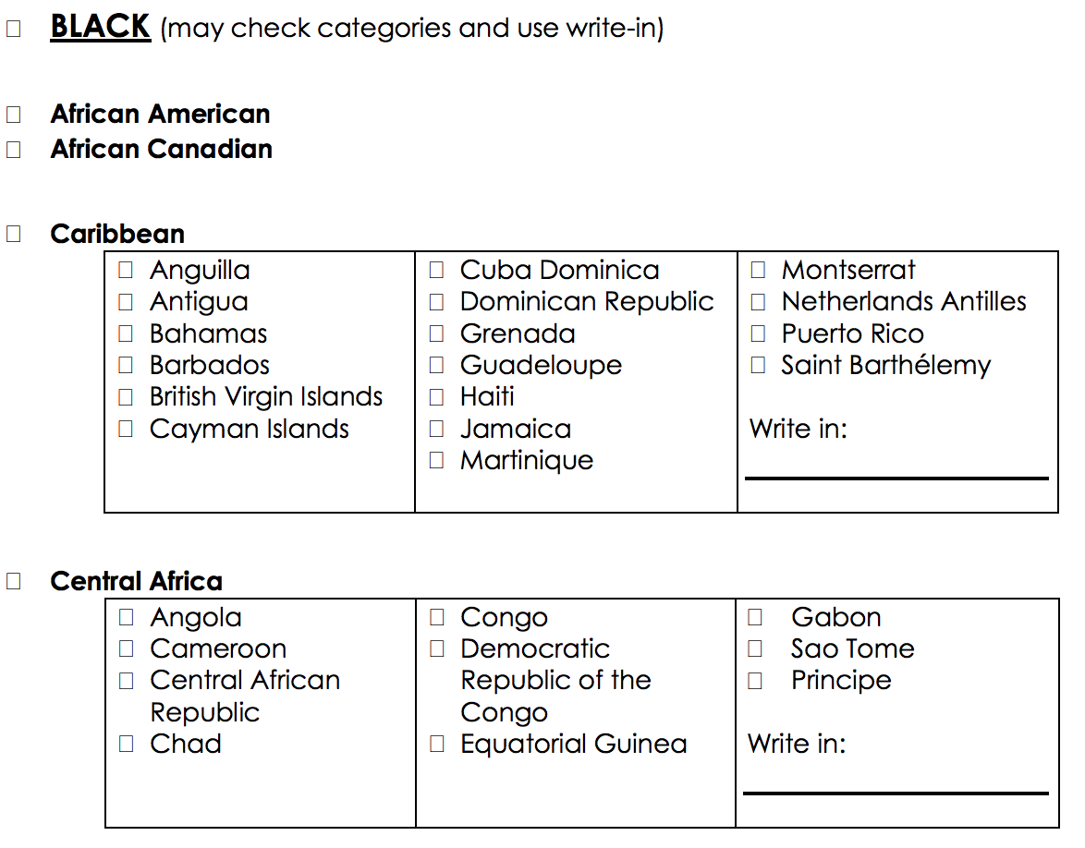
Drafted Data Changes for Black Category
Notes:
DOLLY

Slide 19
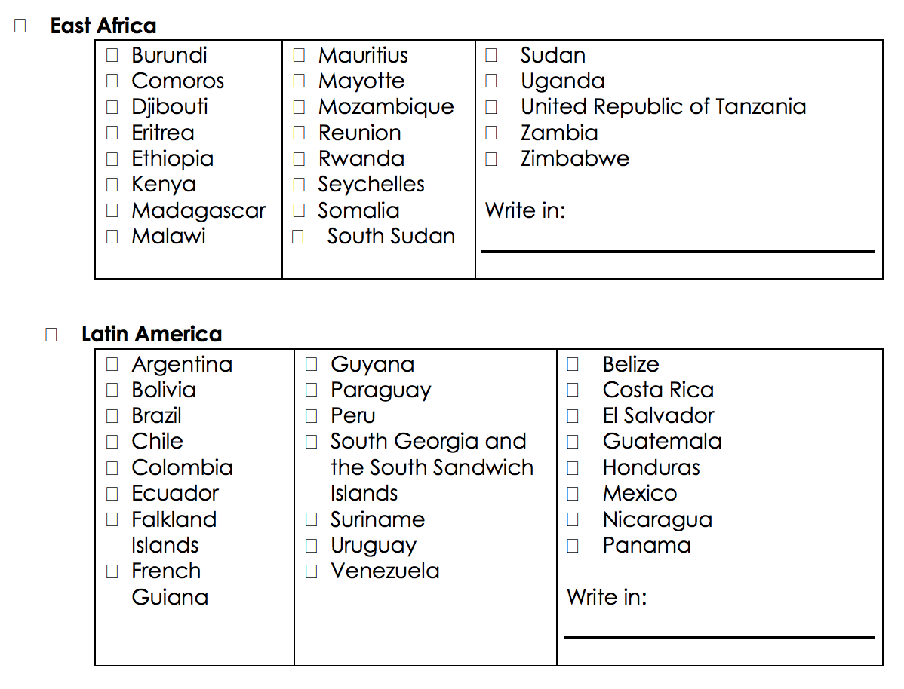
Drafted Data Changes for Black Category
Notes:
DOLLY

Slide 20
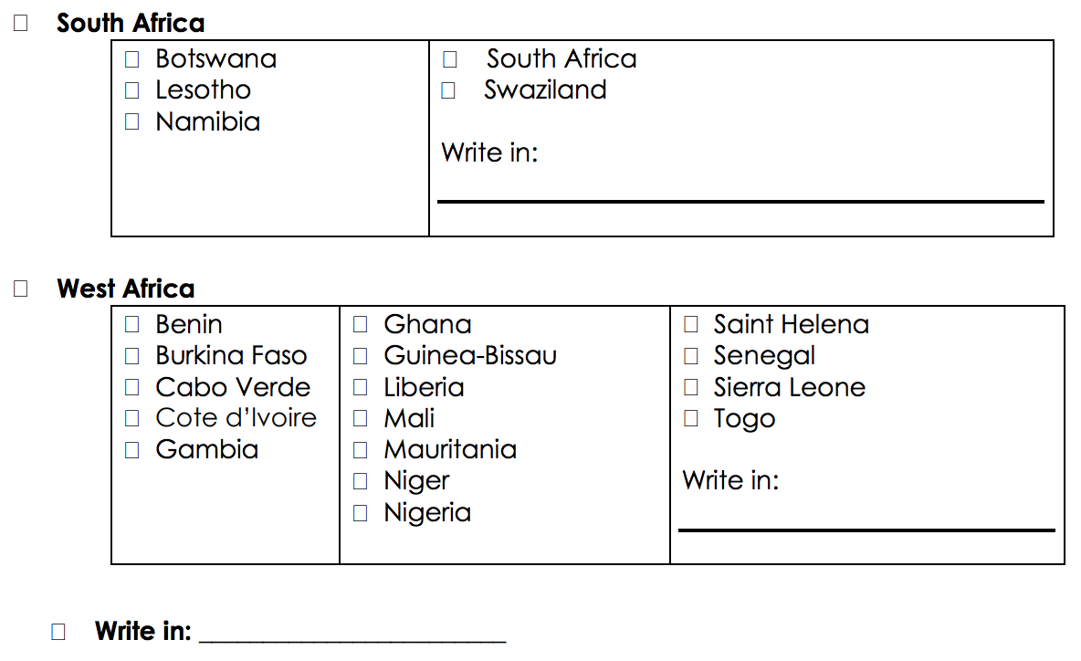
Drafted Data Changes for Black Category
Notes:
DOLLY

Slide 21
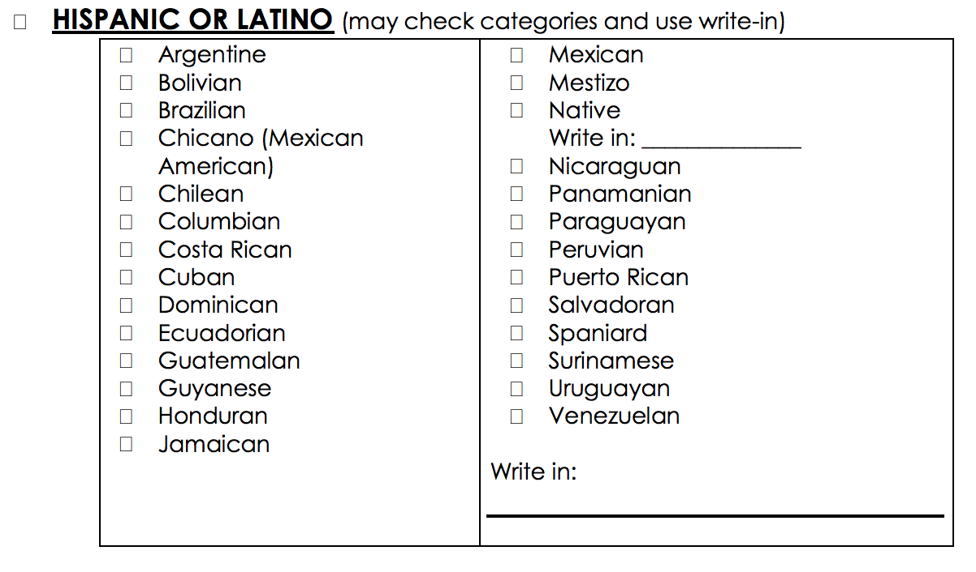
Drafted Data Changes for Latino Category
Notes:
DOLLY

Slide 22
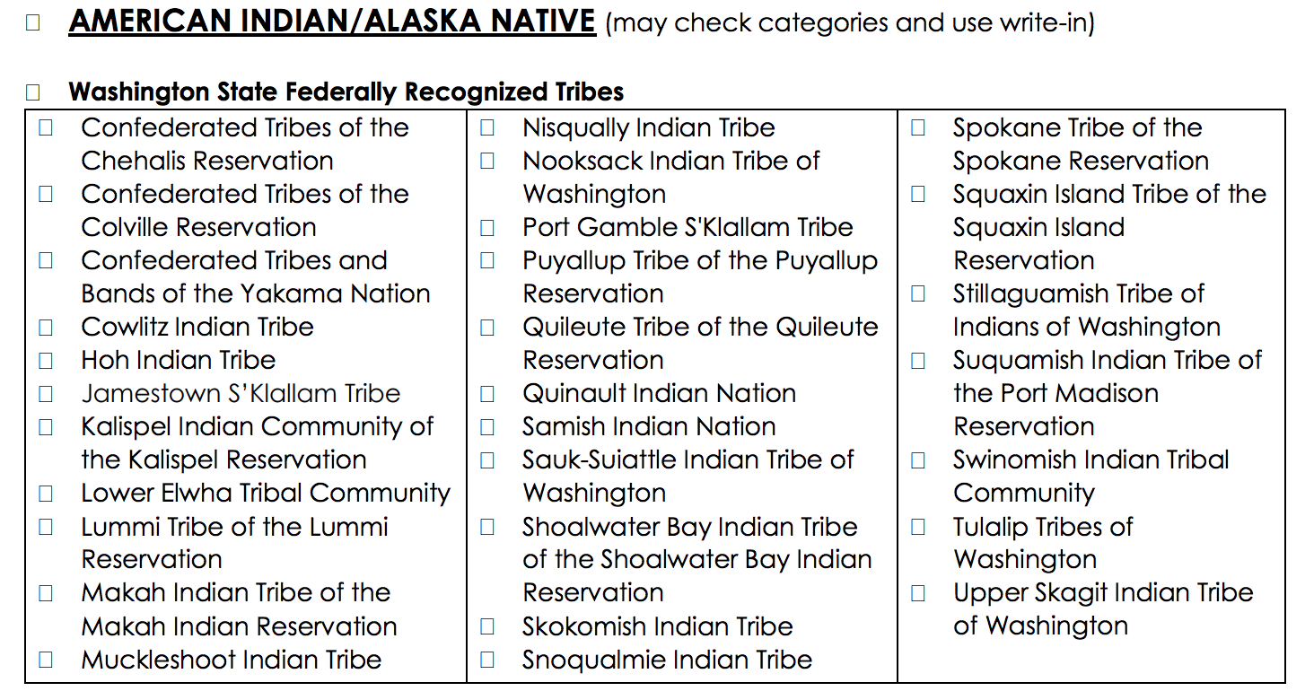
Drafted Data Changes for Native American Category
Notes:
DOLLY

Slide 23
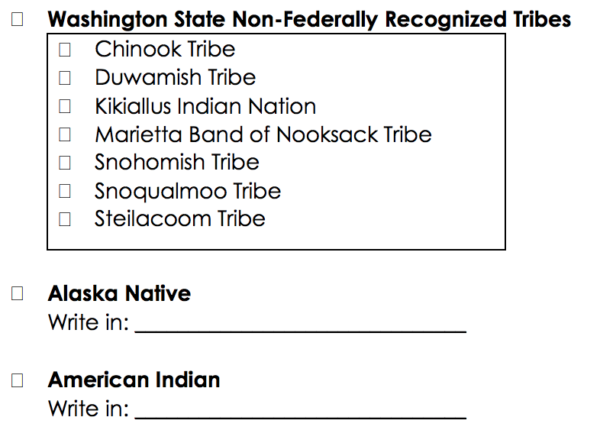
Drafted Data Changes for Native American Category
Notes:
DOLLY

Slide 24
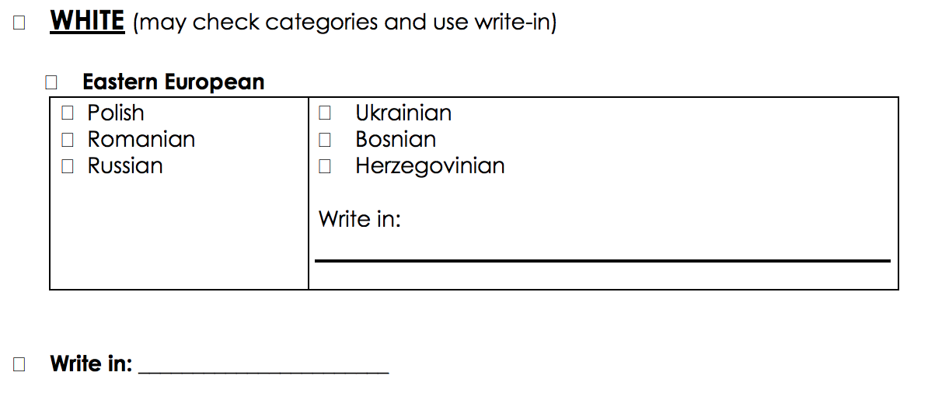
Drafted Data Changes for White Category
Notes:
DOLLY

Slide 25
HOW CAN THESE DATA BE MORE USEFUL TO YOU?

Slide 26
Small Group Discussions
Accessibility
  How, if at all, do you currently access data about your communities?
  Do you know where and how to request data if you need it?
  What, if anything, makes accessing data challenging?
Utility
  What keeps you from using data to inform advocacy for your community/organization?
  What more do you want to know about your communities?
  How can data be packaged in a way that is more useful to you?

