Slide 1
Access is More Than Ramps (… And more than white people)
Carrie Basas
Director, OEO
SESEC 11/15/2018
Notes:
Thanks to Inger and the team for inviting me today
Few things to note as we go:
Please rearrange the space to meet your needs
Flag me down if you need me to go slower, speak louder, clarify
Game plan:
Introduce disability and talk about interplay of racism and ableism
Talk about accessibility and what it means to each of us– table talk
Regroup to talk about kinds of accessibility
Exercise for 30 minutes
Debrief
20 minutes overview
30 minutes activity
20 minutes debrief

Slide 2
Should it matter?
How many people are we really talking about here?
Notes:
20% Americans
Among students– we see an increase in non-apparent disabilities, such as LD, mental health
WHO links disability and poverty– we know that disabilities can be caused by lack of access to resources, violence, trauma, poor health care
And that it can be exacerbated by such factors and also discrimination. Disability does not look like me in the US or globally– not white ladies with canes. ☺
So disability isn’t special– it’s around us, whether or not our systems take note of it
QUESTION: HOW DOES DISABILITY COME UP IN YOUR WORK/BRIEF DISCUSSION

Slide 3
Intersectionality of Oppression and Discrimination: Racism & Ableism
How Do They Reinforce One Another?
Normalcy
Marginalization (historically and currently)
History of “disabling” POC
Which lives “count”
Outcomes (e.g., disproportionality, incarceration, police brutality) and investments (e.g., health, services, education)
Extremes of representation
3
Notes:
Disability rights movement and leadership can be too white, too male, too heterosexual, too English-speaking, too middle and upper class
POC are more likely to have disabilities because of environmental racism, health disparities, and structural racism
Stigma AND discrimination make us sicker
Which differences we value– think about native language
Disproportionality
Historical “disabling” of POC

Slide 4
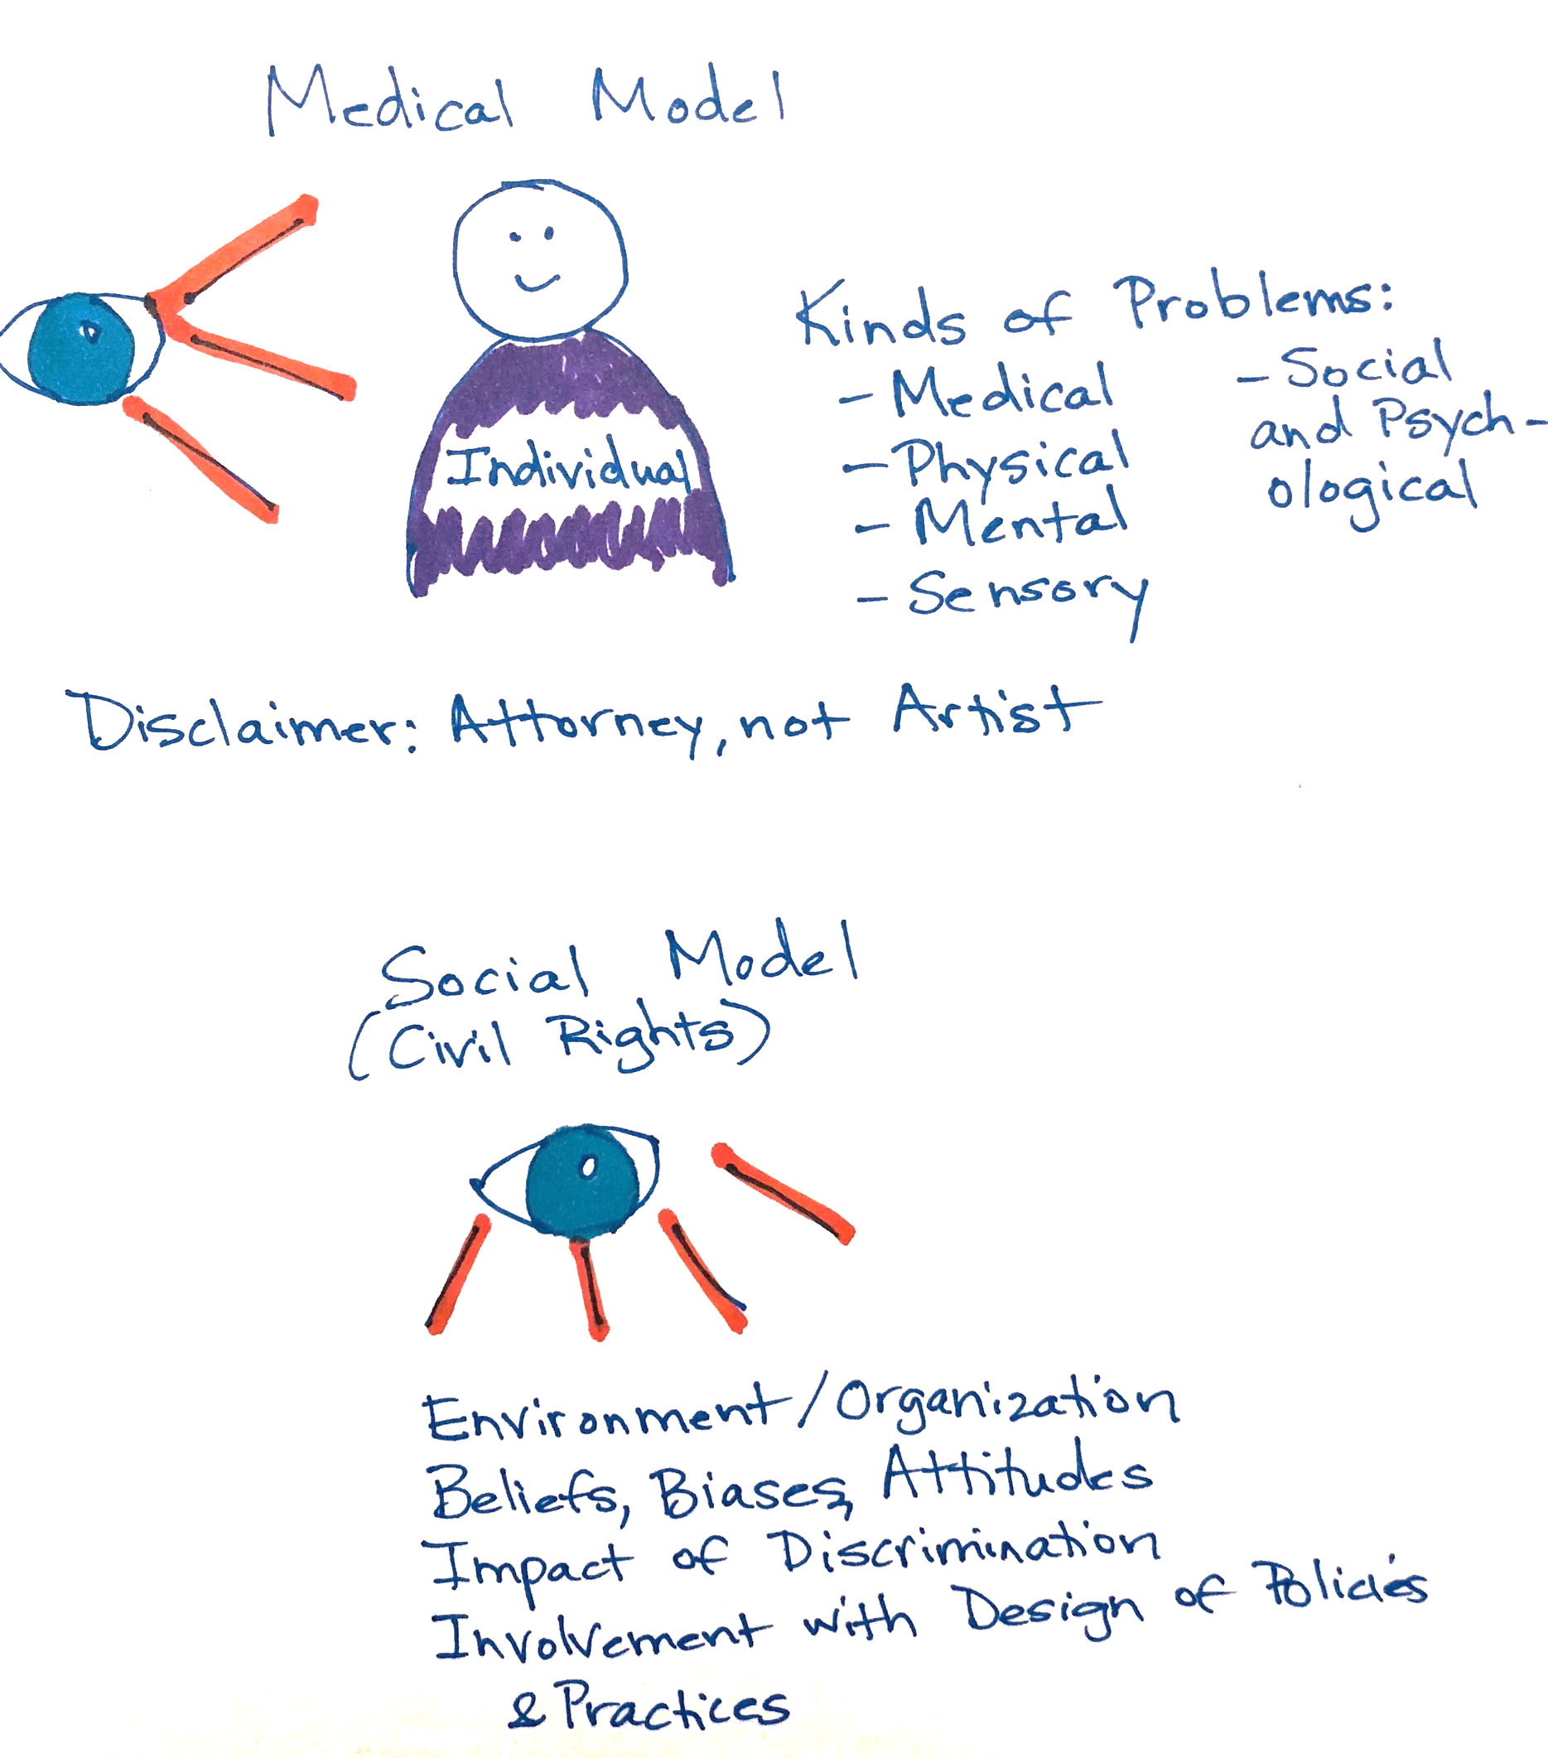
Two Different Ways to Think About Disability
Notes:
Shift in language→ shift in perspectives
Shift for me as well and not something that I knew about until college

Slide 5
Table Talk for 5 Minutes: 1) What’s your definition of accessibility?
2) What’s an example of it that you’d like to improve in your work or community?

Slide 6
From a Universal Design Perspective
Everyone can go, everyone can take part, everyone feels welcome and included
Physical Access
Sensory Access
Cognitive Access
6
Notes:
Physical access: think about the space (wheelchair users, people with mobility devices, blind people)
Sensory: space is safe for people with allergies. Accommodations for people who are blind, deaf, or HOH
Cognitive access: clear information about the event, info in different formats and PLAIN Language, let people know what to expect in advance

Slide 7
Exercise: How to Do It
Each Group Working with a Different Aspect of It, Using Hypo and Guidelines
Great Resources and Some Practice
Resources provided at the end; Checklist to work with now
30 minutes for hands-on activity; 15-20 minutes for debrief
Reflect: What is an item here that offers access beyond disability? How does accessibility advance racial justice? What’s missing from this focus on 3 buckets of access?
7
Notes:
(10 minutes and then return)

Slide 8
Resources for Accessible Meeting Planning
You can find complete guides:
https://disability.cornell.edu/docs/accessibility-checklist.pdf
http://sudcc.syr.edu/_documents/InclusiveEventsSeminarsGuide.pdf
http://socialinclusionweek.com.au/1456/images/AccessibilityChecklist-SocialInclusionWeek_2017.pdf
https://www.americanbar.org/content/dam/aba/administrative/mental_physical_disability/Accessible_Meetings_Toolkit.authcheckdam.pdf
8
Notes:
Give out ableism bingo cards

Slide 9
Additional Resources
Ideas to Explore Later
Working Definitions for Disability Rights:
Ableism:
http://www.stopableism.org/what.asp
Sanism:
http://www.ivacheung.com/2015/05/sanism-and-the-language-of-mental-illness/
“Inspiration porn”:
https://www.ted.com/talks/stella_young_i_m_not_your_inspiration_thank_you_very_much
The myth of the supercrip:
https://themighty.com/2015/12/challenging-the-supercrip-stereotype-of-people-with-disabilities/
Disability identity:
https://www.youtube.com/watch?v=OkPVGBb7CAw&feature=youtu.be
Learn More and Connect:
Job Accommodation Network
https://askjan.org/
US DOL Office of Disability Employment Policy
https://www.dol.gov/odep/
American Association of People with Disabilities
https://www.aapd.com/
ADA.gov
https://www.ada.gov/
Universal Design for Learning
http://www.cast.org/our-work/about-udl.html#.WpRwJOjwY2w
9

Slide 10
Resources at the Intersection of Race and Disability
Understanding how racism and ableism reinforce one another
Book to read: DisCrit―Disability Studies and Critical Race Theory in Education (Disability, Culture, and Equity Series) Paperback – December 30, 2015 by David J. Connor (Editor), Beth A. Ferri (Editor), Subini A. Annamma (Editor), et al.
Vilissa Thompson: Ramp Your Voice: http://rampyourvoice.com/welcome-to-ramp-your-voice/
Twitter: #disabilitytoowhite
Lydia Brown: Autistic Hoya: http://www.autistichoya.com/p/about.html
Alice Wong: Disability Visibility Project: https://disabilityvisibilityproject.com/about/
National Coalition for Latinx with Disabilities: http://www.latinxdisabilitycoalition.com/
National Study on the Experiences of Natives with Disabilities: https://nativenewsonline.net/currents/major-survey-american-indians-disabilities-released/
Asians and Pacific Islanders with Disabilities of California: http://apidisabilities.net/
And if you are interested in community art that looks at the intersection of POC, gender-nonconforming, and LGBTQ experiences: http://www.sinsinvalid.org/
10

Slide 11
Stay in Touch with OEO
Our website: http://www.oeo.wa.gov
We are here to help:
Direct email: carrie.basas@gov.wa.gov and Phone: 206-430-0753
Office email: oeoinfo@gov.wa.gov
Toll free phone: 1-866-297-2597 (interpreter services available)
Join our list-serv:
https://public.govdelivery.com/accounts/WAGOV/subscriber/new?category_id=WAGOV_C5
Facebook: https://www.facebook.com/WAEducationOmbuds/
En Español: https://www.facebook.com/OmbudsdeEducacion/
11

