Slide 1
SESEC presentation
Oct. 15 2015

Slide 2
What will be discussed:
Regional efforts – home language campaign, world language credits
State policy – seal of biliteracy, dual language programs, and the world language credit
Why?

Slide 3
Data for ELL students

Slide 5
Discussion questions
What stood out to you?
Do you see any of these points playing out from where you do your work?
What do you think needs to be in place to change negative experiences in the school system for immigrant and refugee students?

Slide 6
Experiences from our region
We feel very frustrated when our kids are suspended or reprimanded. We don’t know what recourse to take and often we find out too late about what is going on.
-Parent Focus Group
“The teacher doesn’t pay attention to me because I don’t speak English, and so I don’t know who to go to when there is a problem in school.”
-Student Interview
“I don’t like visiting the school. I don’t feel a connection. We are new to this country. Schools need to do a better job reaching out and saying this your school.”
-Parent Focus Group
“I need better English (skills), but I also need more (of a) regular English, history, and science foundation.”
- Student Interview
“Current generations are losing their native language. They need to learn their mother tongue as well as English.”
-Parent Interview
“Math is really hard for me. I think mainly because of the English and when I have to switch my language to Spanish.”
-Student Interview

Slide 7
Deficit perspective→ Asset-based
Concrete examples we are trying to shift and why:
Those working with students and families may see ability to switch between English and another language as a problem to be fixed rather than skill to be developed
Those working with students may attempt to acculturate them away from home language in service of being English-focused
Strong ties to a students family and heritage can promote learning while alienation inhibits cognitive and socio-emotional development

Slide 8
Changing demographics
In last decade in our state, students who speak a language other than English at home has risen by over 70%.
By 2025, 1 in 4 students will be ELLs in our state
We MUST change the way our education system supports and engages diverse communities

Slide 9
Regional – Speak Your Language!
Use a regional campaign to build the local capacity of school districts, community-based organizations, and the early learning system to message the importance of home language development using a key set of messages
Audience: Parents and those that interact with parents

Slide 10
Key Messages
Learning more than one language is good for your child because:
Teaching your home language will help your child develop a deep and lasting connection to their culture
Knowledge of more than one language helps build your child’s brain
Young children have the unique ability to learn many languages at the same time
Children who know more than one language have increased concentration and creativity
A young person that graduates speaking two or more languages will have many more job opportunities and higher earning potential
Sharing your mastery of the home language gives your child the foundation to learn English more effectively
When a child develops their home language it builds their positive identity and connection to their culture and heritage
Continue to speak to your child in their home language throughout their life to help them retain their multilingual skills
From classrooms around the country we see that dual language programs are the best learning environment for students

Slide 11
Implementation of the Campaign
Strategy 1: OneAmerica create parent friendly handout with key messages translated into 10-13 languages to be used by all partners in the campaign (currently exploring partnering with the State to translate all the messages into 36 languages)
Strategy 2: 2-3 school districts in South King County implement a 60 minute outreach program for parents by December 2015, using the translated World Language Credit Videos and the home language campaign key messages.
Strategy 3: Build capacity of smaller CBOs working closely with communities. Partner with South East Seattle Education Coalition (SESEC) to develop their own strategies for implementing the key messages and using the translated WLC videos through granting

Slide 12
Implementation Plan (continued)
Strategy 4: Build avenues/capacity within the B-3rd grade system to communicate the importance of home language
Strategy 6: Develop a media strategy to uplift and spread messages

Slide 13
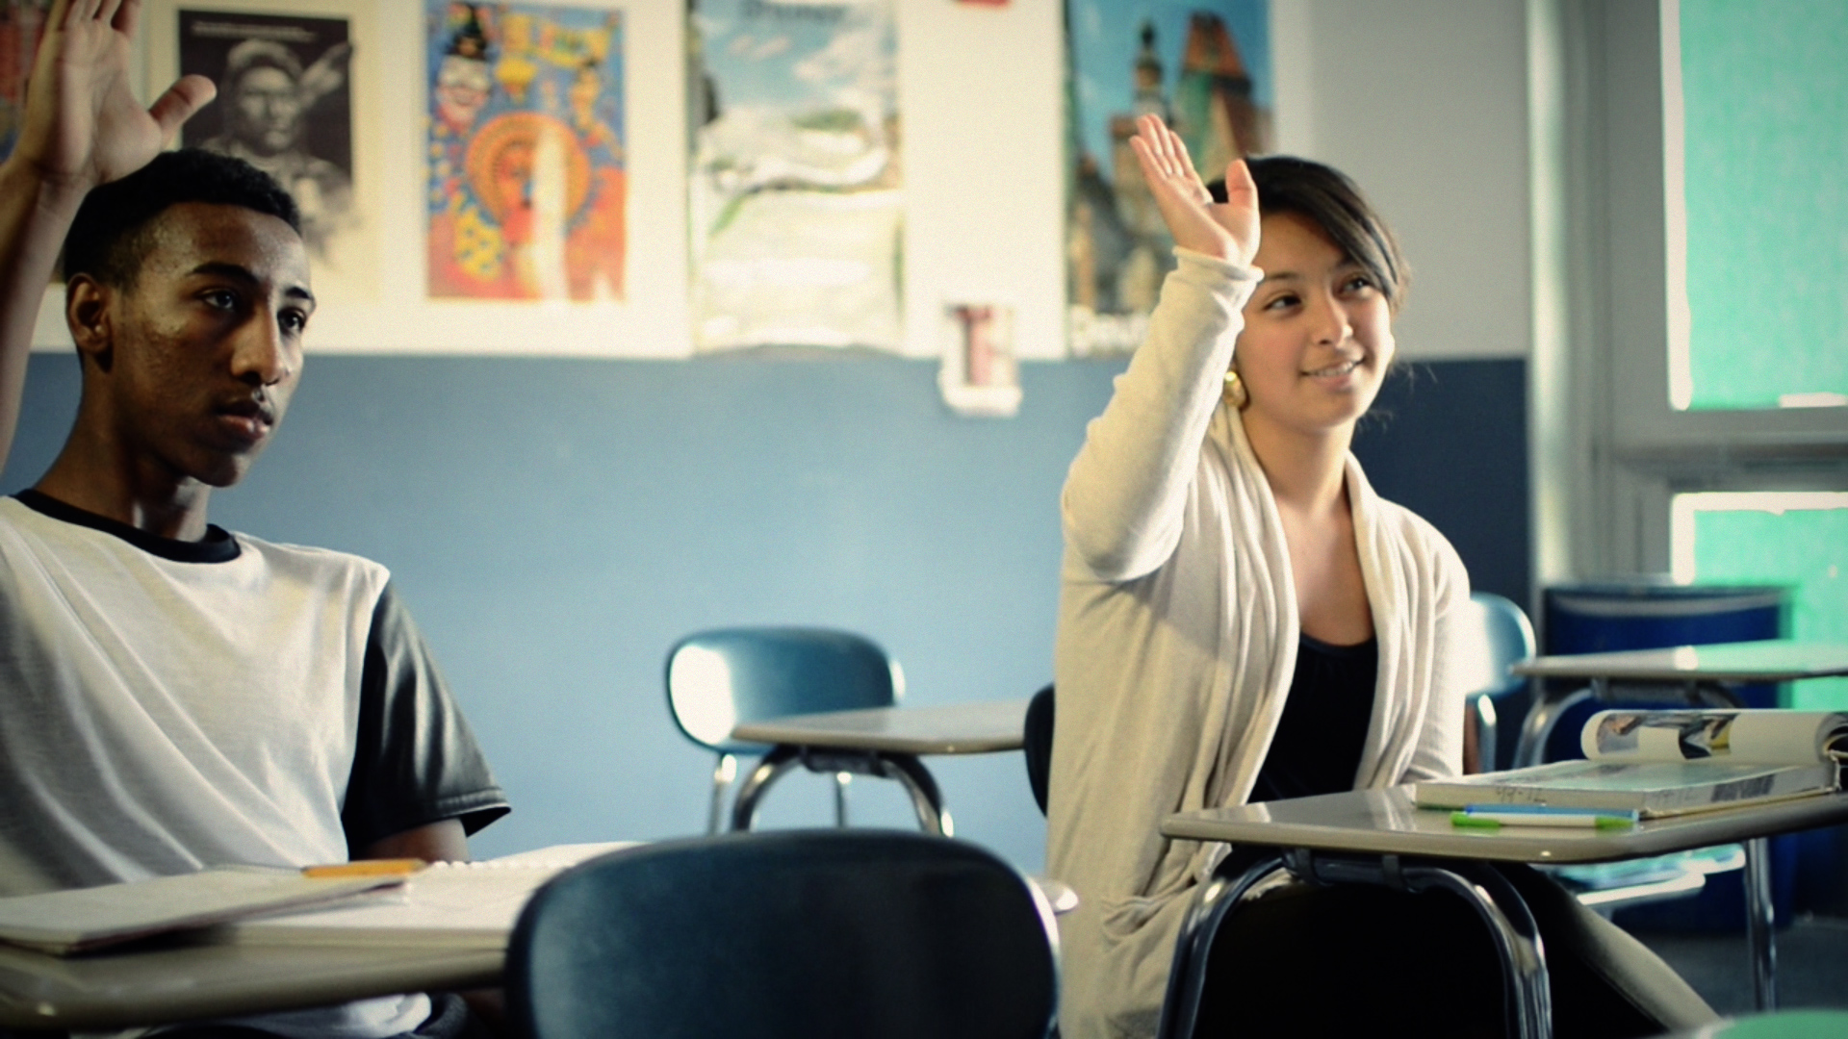
World Language Credit Program
Notes:
Over 1500 competency-based credits have been earned by students across the state

Slide 14
State policy
Seal of biliteracy
Dual language programs

Slide 15
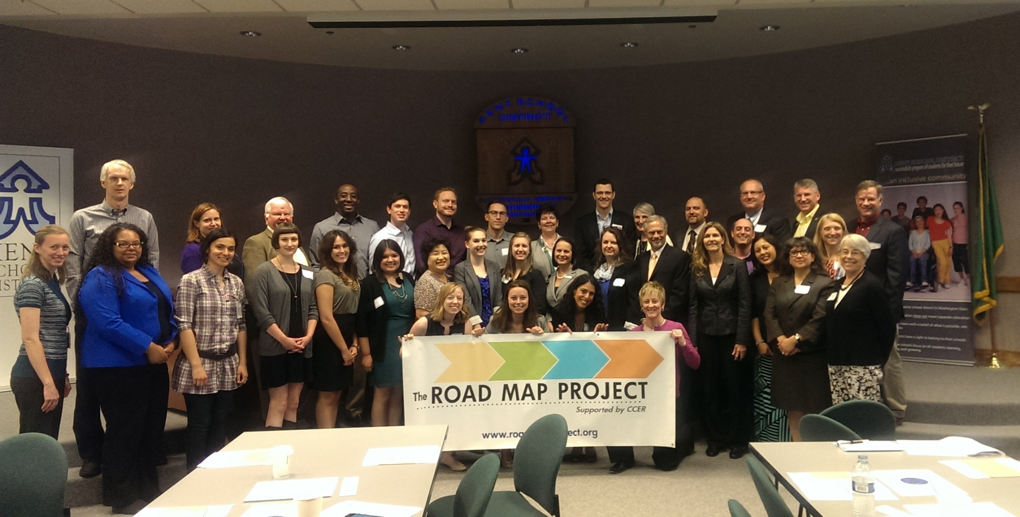
Expanding dual language programs
Research shows that well-implemented dual language programs are the most effective way to teach ELL students
This year our state invested $500,000 in expanding current and creating new dual language programs across the state

Slide 16
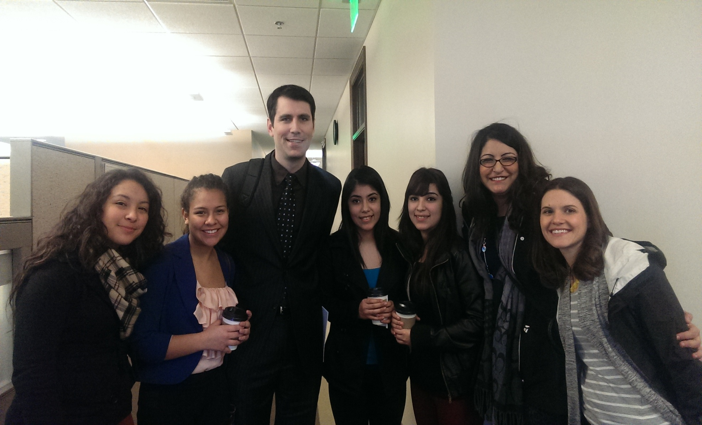
Building public will & moving our state

Slide 17
Signing of the Seal of Biliteracy
Notes:
662 students have received the seal so far

Slide 18
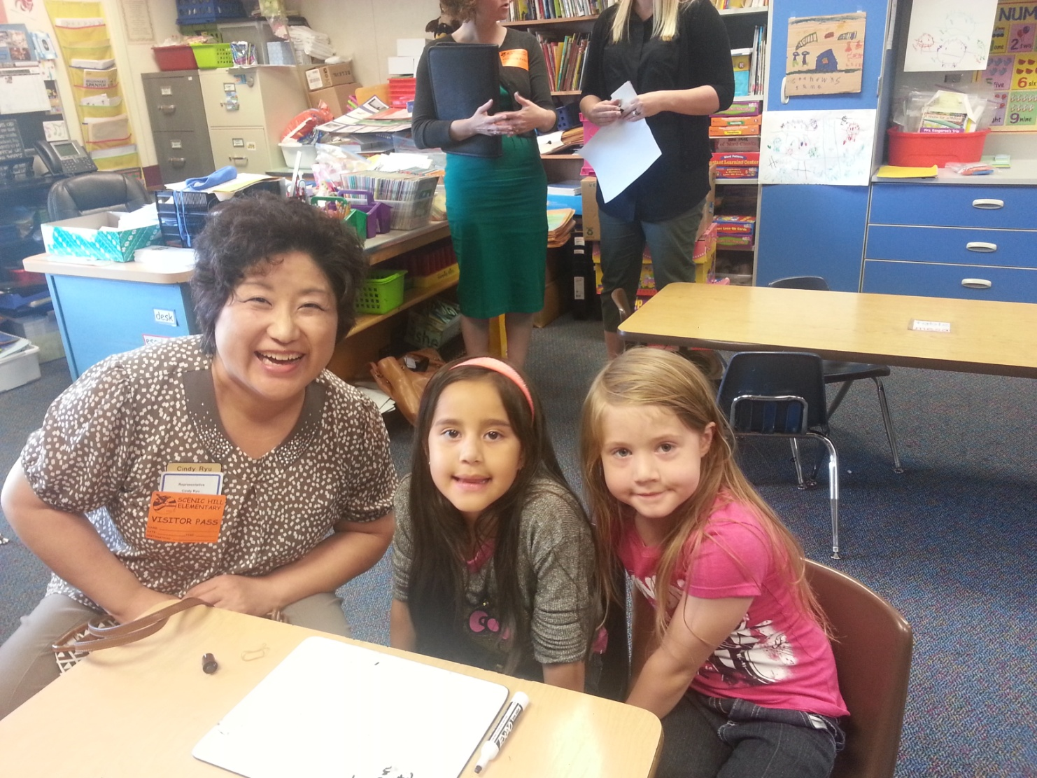
Legislators visiting dual language classrooms in Kent

Slide 19
Questions/Input
What ideas do you have of policies and systems-change that needs to occur to improve outcomes for immigrant and refugee students?
What input do you have for OneAmerica/what should we be considering?
What might you do in your own work?
What questions do you have about our work?

